Slide 1



Digital Skills Training - AI
Community Champions Program

Slide 2
Trainer Notes: Introduction to AI
Print this handout for participants:
  Introduction to AI
Print a single copy of these slides with the notes section for you to use when presenting
Read
  through the slides, and make sure you are familiar with the content
  the handout for participants
Get in touch with Elliot Elliot@wacoss.org.au before the session if you have any questions
Remove/hide this slide before presenting and update the time/date of the next session on the final slide. Check the country on which you’re facilitating to make sure it is correct.
Update the second last slide with information about your next DI Session

Slide 3
Acknowledgement of Country
We know we are on Aboriginal land. We respect Aboriginal people from this land.
Aboriginal people have lived on this land for many years.
We respect all Aboriginal people and their Elders.
We can learn a lot from their stories.
This land always was and always will be Aboriginal land.

Slide 4
Artificial Intelligence (AI)
WA Digital Inclusion Project

Slide 5
Session overview
This session will cover:
What is AI?
Examples of different types of AI
What’s good about AI
How to use AI safely
Notes:
Greet everyone, Introduce yourself.
Explain the workshops purpose – to provide an overview of Artificial Intelligence.
Highlight the importance of using AI, for life, learning and work..
Discuss the different uses of AI and how people might already be using it without knowing. Include that you will be talking about how to use AI safely. Remind them to attend future training about online safety.

Slide 6

Introductions
Introduce yourself to the group
Share your experience with AI – have you used AI before?
Notes:
Ask each participant to Introduce themselves with:
their name and
one interesting fact about themselves.
Limit each Introduction to 30 seconds to keep it brief and engaging.

Slide 7
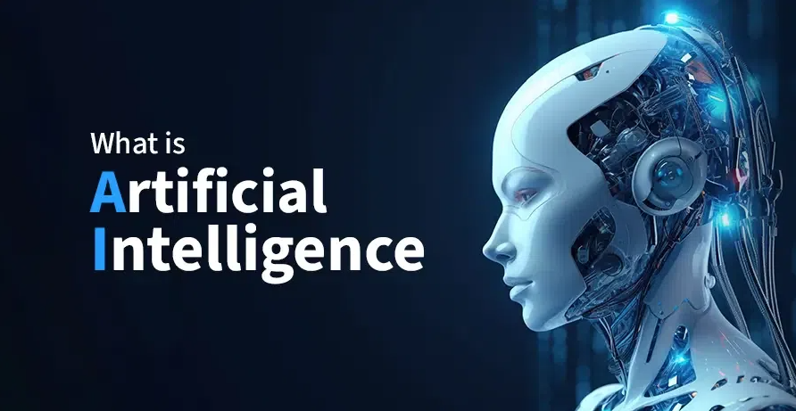
Notes:
Ask participants:
“What comes to mind when you hear the term AI?
Can you think of any examples you’ve seen or used?”
Definition:
AI stands for Artificial Intelligence.
It means a computer program that does things like a human. It is designed to do things that usually need a human to think about them.
Some examples include:
Understanding spoken or written words,
Recognising images or faces,
Making decisions, or
Learning from what’s happening.
Simply put, AI is when a machine is built to ‘think’ or ‘act’ in ways that seem smart. They pretend to act like a person, but they don’t really understand things like people do.
The next slide has some examples.

Slide 8
What can AI do?
Making suggestions:
Streaming Services
Grocery Shopping Apps
Social Media
Organise things:
Photo apps on your phone
Alert you of important things:
Smart Security systems
Fitness trackers
Completing simple tasks or providing customer service:
Voice Assistants
Online chat bots
Notes:
Common Ways AI Shows Up in Everyday Life
AI is already part of many tools and apps we use — often without us even noticing. It makes things easier, faster, or more personalised.
Here are some everyday examples:
1. Making Suggestions
AI looks at what you like or use often, then suggests similar things:
Streaming apps (like Netflix or Spotify) suggest shows, movies or music. They do this based on your viewing or listening habits.
Grocery shopping apps recommend products based on your regular purchases.
Social media shows you posts or accounts like ones you’ve liked or followed.
2. Sorting and Organising
AI helps sort things to make them easier to find:
Photo apps can recognise faces and group photos by person or event.
Email apps often sort messages into categories like “Primary,” “Promotions,” or “Spam.”
3. Sending Alerts
AI can track activity and let you know when something changes:
Smart security systems detect movement and send alerts.
Fitness trackers can analyse your sleep, exercise, and heart rate. They might also notify you about health trends.
4. Helping with Tasks or Questions
AI can respond to instructions or questions:
Voice assistants like Siri or Alexa can set alarms, play music, or answer simple questions.
Online chatbots help you find products or information on websites. They can oftengive you help 24/7.
AI is becoming part of everyday life. It’s often working quietly in the background to make things easier or more personal.

Slide 9



AI specific websites
AI websites can do things like:
Generating images based on your description
Creating music
Writing stories, articles, instruction manuals, or emails
Help generate ideas for brainstorming
Help with solving problems or providing tutoring for students
Play games with you
Provide or create recipes
Notes:
AI Websites and What They Can Do
Some websites are built only to use AI.
Examples are ChatGPT, Microsoft Copilot, Google Gemini, and OpenAI tools.
These platforms can do a wide range of tasks, often based on what you ask them.
Here are some examples of what AI websites can help with:
1. Create Content
Write stories, articles, emails, or instructions
Generate ideas for brainstorming or creative projects
Help students with tutoring or explanations
2. Make Art and Music
Create images based on your description (e.g. “a sunset over the ocean”)
Compose music in different styles or moods
3. Solve Problems
Answer questions or explain complex topics
Help with planning, like creating recipes or travel itineraries
4. Play and Interact
Play games or quizzes
Chat with you in a conversational way
Key takeaway:
AI websites are improving all the time. The more people use them, the better they get at understanding. The more they understand, the better they respond to different requests. You can ask them to do all sorts of things — and they’ll try their best to help.

Slide 10
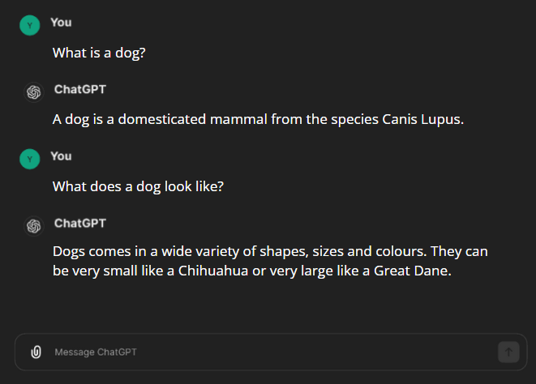
How does AI learn?
Collecting lots and lots of information by:
Scanning & reading everything online!
Interacting with humans and learning from them.
Notes:
How Does AI Learn?
AI gets smarter by collecting and analysing huge amounts of information. It learns in two main ways:
1. Reading Everything Online
AI systems scan:
websites,
books,
articles, and
other digital content
to learn facts, patterns, and language.
2. Learning from People
Every time someone uses AI, the system learns what people are looking for.
Example: Asking About Dogs
Let’s say you ask an AI:
“What is a dog?”
You might get a basic answer, but it’s not quite what you wanted. So you rephrase it:
“What does a dog look like?”
Now the AI gives you a better answer.
After the conversation ends, the AI reviews the whole chat.
It learns that when someone asks “What is a dog?”, they might want a description of its appearance.
Next time someone asks that question, the AI includes more useful details.
AI Learns from Every Interaction
AI tools like ChatGPT answer over 1 billion messages every day — and there are more than 70,000 AI tools out there. That’s a lot of learning!
Over time, the answers get better. For example, if you ask “What is a dog?” today, you might get:
Basic facts (species, lifespan)
Physical traits (size, fur, colours)
Behaviour and senses
Jobs (guide dogs, police dogs)
Fun facts
That’s because thousands of people have asked similar questions. Because of that AI has learned what details are most helpful.
AI Keeps Evolving
The answers you get today might be different in six months. This is because AI is always learning and improving.

Slide 11
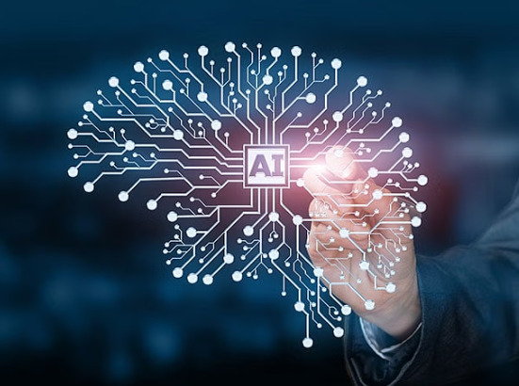
What is good about AI?
Save you time by performing small tasks
Helping companies provide customer service
Automating tasks and reducing human error
Helping people with disabilities
Notes:
How AI Can Help Us in Everyday Life
AI can be incredibly useful in many areas of life. Here are some of the ways it’s already making a difference:
1. Making Daily Tasks Easier
Virtual assistants like Siri or Alexa. They can set reminders, play music, or answer questions.
Navigation apps use AI to suggest the fastest route and avoid traffic.
2. Improving Healthcare
AI can analyse large amounts of medical data to help doctors make better decisions.
It can also spot patterns that humans might miss, leading to earlier diagnoses.
3. Supporting Businesses and Customers
AI helps companies offer 24/7 customer service through chatbots.
It can also provide personalised support. It can recommend products or services based on your needs.
4. Helping with Big Data and Research
AI can process huge amounts of information quickly — much faster than a person could.
This helps with scientific research, climate modelling, and predicting trends.
5. Reducing Errors and Saving Time
AI can automate repetitive tasks, reducing the chance of human mistakes.
It helps people work more efficiently by handling routine jobs.
6. Supporting People with Disabilities
AI tools can assist people with speech impairments or other disabilities. They help them communicate or interact with technology.
7. Enhancing Security
AI can detect false banking transactions and alert you to questionable activity.
Key takeaway:
AI is already helping people in many ways, often behind the scenes. Its benefits are growing every day.

Slide 12
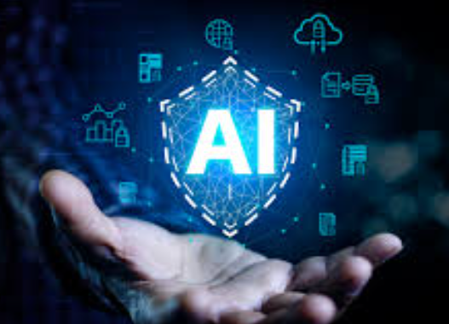
What do we need to be aware of?
Deep fakes
Privacy and data protection
Old information (lack of updates)
Misinformation
Notes:
The Risks and Challenges of AI
AI can be very helpful, but it also has a darker side. It’s important to be aware of how it can be misused or cause problems.
1. Deepfakes
AI can copy someone’s voice or appearance to create fake videos or audio. It could be used to make trusted people appear to say things they never said. Sometimes people use it on celebrities or politicians to trick others.
2. Privacy and Data
Free AI tools (like ChatGPT) often collect and store the information you enter.
This means your data isn’t always private. Companies may use it to improve their systems or for other purposes.
3. Outdated Information
Some AI tools aren’t updated regularly.
For example, ChatGPT once gave old answers about who the ruler of England was. It said Queen Elizabeth II, months after she passed away.
Always double-check important facts from reliable sources.
4. Misinformation
AI learns from people — and people sometimes share biased or incorrect information.
This means answers can be misleading, incomplete, or just plain wrong.
Key takeaway:
AI is powerful, but it’s not perfect. Always use it with care. Think critically about the answers you get. Protect your personal information.

Slide 13
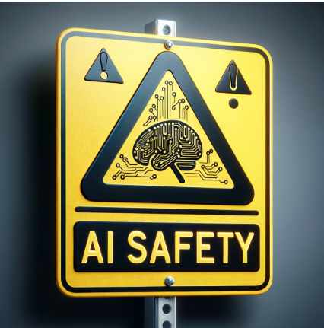
How do you use AI safely?
Double check the information you get from AI
Never share personal information
Understand the limitations of AI
Trust your gut!
Notes:
How to Use AI Safely
AI can be incredibly useful, but it’s important to use it wisely. Here are four key safety tips to keep in mind:
1. Double-check the information
AI can sometimes give outdated or incorrect answers.
If the AI provides sources, check them.
If it doesn’t, look up the information on a trusted website or ask a reliable person.
2. Never share personal information
Free AI tools may store everything you type.
Don’t enter personal details like your name, address, passwords, or bank information.
Treat AI chats like public spaces — only share what you’re comfortable with others seeing.
3. Understand AI’s limitations
The more you know about how AI works, the better you can use it safely.
AI doesn’t “know” things — it predicts answers based on patterns.
It can’t always tell what’s true, current, or appropriate.
4. Trust your instincts
If something feels off, it probably is.
If an answer seems strange, confusing, or suspicious, take a step back and double-check.
Don’t rely on AI alone for important decisions.

Slide 14
Reflection
What is AI and what can it do for you?
How does AI learn?
The good side of AI
What to be aware of and how to use AI safely
Notes:
Let’s review the main points from today’s session:
What is AI?
AI stands for Artificial Intelligence.
It means a computer program that does things like a human. It is designed to do things that usually need a human to think about them.
Some examples include:
Understanding spoken or written words,
Recognising images or faces,
Making decisions, or
Learning from what's happening.
Where do we see AI?
AI is used in everyday tools like:
streaming apps,
voice assistants,
photo organisers,
chatbots, and more.
How does AI learn?
AI improves by reading online content and learning from user interactions.
It gets better with every question asked.
Benefits of AI
AI can help with:
daily tasks,
healthcare,
customer service,
accessibility,
fraud detection, and more.
Risks of AI
Be aware of deepfakes, privacy concerns, outdated info, and misinformation.
Using AI safely
Always double-check answers.
Protect your personal data.
Understand AI’s limits.
Trust your instincts.
Open Discussion
Any questions?
Feel free to ask anything about AI or share something you’re still curious about.
Have you used AI before?
Let’s hear some of your experiences — whether it’s using Siri, ChatGPT, or something else. What did you use it for? Was it helpful?

Slide 15
Thank you!

Slide 16
Thank you
Community Champions Program

