Slide 1



Welcome
Community Champions Conversation: Scams

Slide 2
Acknowledgement of Country

Slide 3

Overview
How to spot and avoid scams
  Text Messages
  Phishing
  Fake Websites and Reviews
  Social Media
Reporting scams

Slide 4
How to
spot and avoid scams
Community Champion conversation
Adapted from the Little Book of Scams: How to spot and avoid scams by the Australian Competition and Consumer Commission, 2024, Copyright Commonwealth of Australia, licensed under CC BY 4.0

Slide 5
Help is at hand
If you have been the target of a scammer, you are not alone – but you must act quickly.
Contact your bank or card provider
Contact IDCare on 1800 595 160 or www.idcare.org
Adapted from the Little Book of Scams: How to spot and avoid scams by the Australian Competition and Consumer Commission, 2024, Copyright Commonwealth of Australia, licensed under CC BY 4.0

Slide 6



Protect yourself with these three steps:
1. Stop
2. Check
3. Protect
Don’t give money or personal information to anyone if unsure.
Ask yourself could the message or call be fake?
Act quickly if something feels wrong.

Slide 7
What is a scam?
When someone deceives you to steal money or personal information.
Scams
are run by criminals
look real
come with believable stories
pressure you to take action
A scam is NOT:
X Computer hacking X Unfair Contract terms X Harassing marketing approaches

Slide 8
How to
spot and avoid scams
Adapted from the Little Book of Scams: How to spot and avoid scams by the Australian Competition and Consumer Commission, 2024, Copyright Commonwealth of Australia, licensed under CC BY 4.0

Slide 9
How to spot and avoid scams:
Opportunities to make or save money
Sad stories and cries for help
Links and attachments
Pressure to act quickly
Requests that you pay in unusual or specific ways
Request to set up new accounts or PayIDs
Adapted from the Little Book of Scams: How to spot and avoid scams by the Australian Competition and Consumer Commission, 2024, Copyright Commonwealth of Australia, licensed under CC BY 4.0

Slide 10
Text or SMS scams
Messages will sound urgent
and try to get you to act quickly.
Adapted from the Little Book of Scams: How to spot and avoid scams by the Australian Competition and Consumer Commission, 2024, Copyright Commonwealth of Australia, licensed under CC BY 4.0

Slide 11
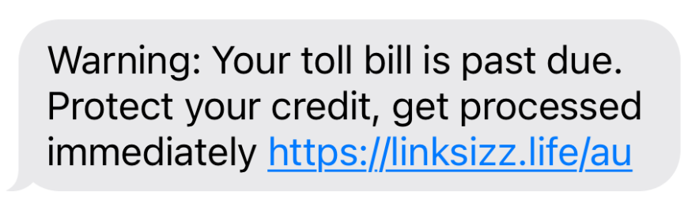
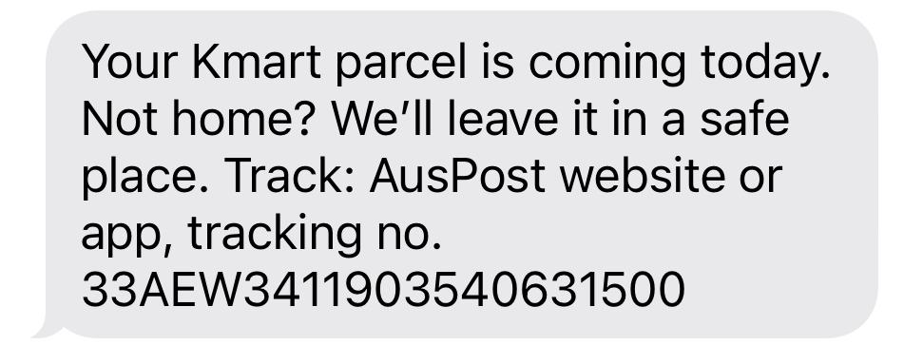
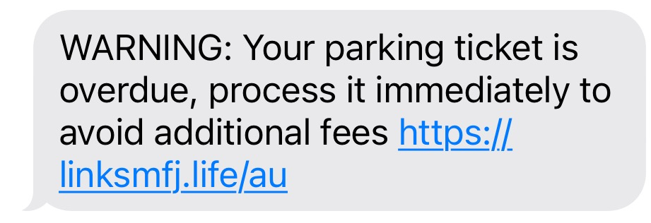
Scam Test!
Which one of these do you think is real?
Notes:
Ask the group which one they think is real and why?
The next slide will give them the answer!

Slide 12
Scam Test!
Which one of these do you think is real?
This is the real message, and we can check in other ways!

Slide 13
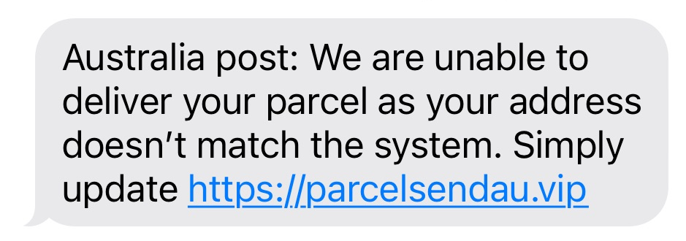
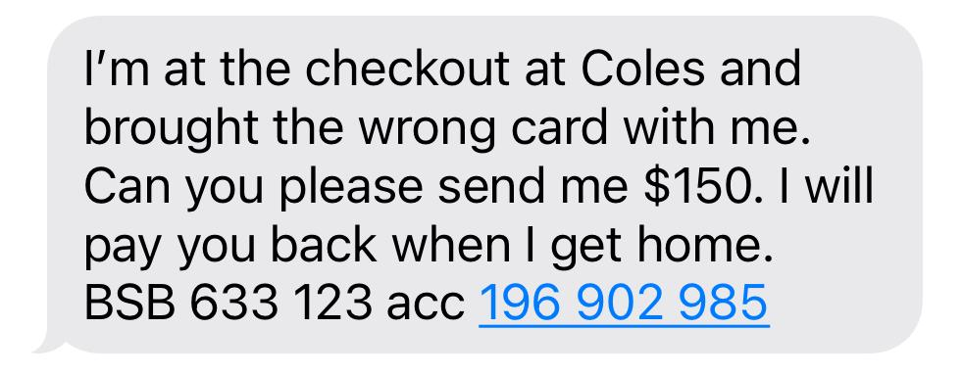
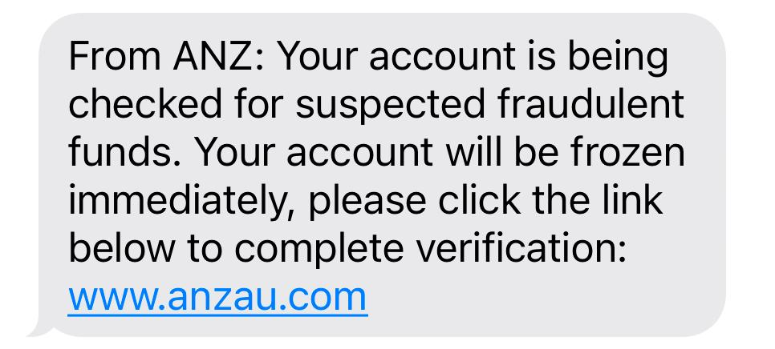
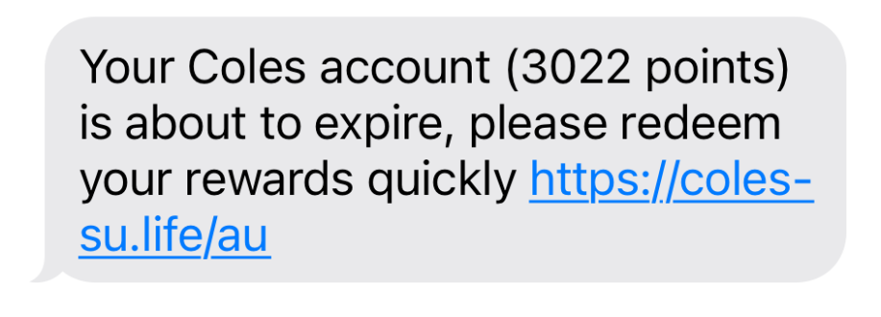
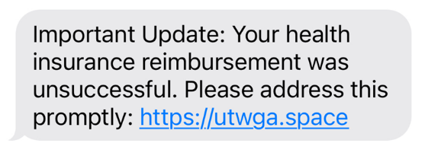
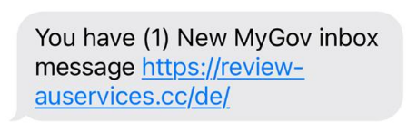
SMS Scams – More examples!
Notes:
Read through the messages.
Remember that scammers might:
Try to rush you or create a sense of urgency.
Pressure you by threatening your credit or fees of some sort.
To be safe, always:
Pause and verify before acting
Always double-check messages and avoid clicking suspicious looking links.

Slide 14


Romance Scams
When a scammer takes advantage of people looking for love online.
They often pretend to have feelings for you and then ask you for money once you trust them.
If you are using dating apps or websites, make sure you confirm someone’s identity, in person where possible.
Notes:
Romance scams:
When a scammer takes advantage of people looking for love online.
Scammers often pretend to have feelings for you and then ask you for money once you trust them.
There is no shame in telling someone that you:
cannot give them money, or
that you think you have been scammed!

Slide 15
Email scams
Scammers use the same logo and a similar email address as a real organisation
Adapted from the Little Book of Scams: How to spot and avoid scams by the Australian Competition and Consumer Commission, 2024, Copyright Commonwealth of Australia, licensed under CC BY 4.0

Slide 16


Phishing Scams
Scammers send fake emails from someone like the bank or Government.
They will usually ask you to send them personal information.
Once they have enough details, they can pretend to be you.

Slide 17
Phone Scams
A caller may already have some details about you, such as
your name or address.
Adapted from the Little Book of Scams: How to spot and avoid scams by the Australian Competition and Consumer Commission, 2024, Copyright Commonwealth of Australia, licensed under CC BY 4.0

Slide 18

Mundy, Garrett (2024, October 30). Elderly Perth woman targeted in $2,000 gift card scam. ABC News.
https://www.abc.net.au/news/2024-10-30/woman-in-gift-card-scam-taken-to-shop-by-taxi/104528608

Slide 19
Website scams
Websites can contain fake reviews to make you trust them
Adapted from the Little Book of Scams: How to spot and avoid scams by the Australian Competition and Consumer Commission, 2024, Copyright Commonwealth of Australia, licensed under CC BY 4.0

Slide 20


Fake Websites have been created
Scammers create fake ads or websites selling products.
They will take your money and never provide you with the product.
Always check you’re on the right site.

Slide 21


Scambling: Online gambling scams
🎰
Scams disguised as gambling apps or games.
Fake jackpots and free spins trick people into giving money or personal details.
Don’t share sensitive information or transfer money, check apps before downloading and report anything suspicious.
Boltje, S., (2025, August 29). ‘Scambling is an online gambling scam targeting First Nations communities. https://www.abc.net.au/news/2025-08-29/scambling-the-online-gambling-scam-targeting-aboriginal-people/105709290

Slide 22
Social media, app-based and online messaging scams.
Scammers can learn a lot about you from your social media accounts.
Adapted from the Little Book of Scams: How to spot and avoid scams by the Australian Competition and Consumer Commission, 2024, Copyright Commonwealth of Australia, licensed under CC BY 4.0

Slide 23



Sharing on social media
Consider what information the bank uses to identify you. Or your passwords.
Your date of birth
Address
Pet names
Anything else personal?
Be careful what you share on social media as this information could be gathered from the images and the information you share.

Slide 24


Marketplace Scams - Fake Ads
Protect yourself from scams and misunderstandings, keep these tips in mind:
Never pay for an item, especially a deposit, until you’ve seen it
Don’t hand over an item until you’ve received full payment

Slide 25

Scammers use technology to make their calls or messages appear to come from a legitimate phone number.
Adapted from the Little Book of Scams: How to spot and avoid scams by the Australian Competition and Consumer Commission, 2024, Copyright Commonwealth of Australia, licensed under CC BY 4.0

Slide 26
Common scams
Impersonation Scams
Investment Scams
Jobs and employment scams
Products and services scams
Romance scams
Threats and extortion scams
Unexpected money scams
Adapted from the Little Book of Scams: How to spot and avoid scams by the Australian Competition and Consumer Commission, 2024, Copyright Commonwealth of Australia, licensed under CC BY 4.0

Slide 27
Tips to stay safe online
Beware of suspicious phone calls.
Be cautious with texts you receive.
Make your passwords strong.
Be careful on Social Media.
Trust your gut!
Notes:
Tip 1 - If someone calls you and asks for personal information:
Take down their details and hang up. You can say “I didn’t ask you to call me, so I am going to hang up the phone now”
Find their real number from their website. Call them back on it.
Tip 2 - Be Cautious with Texts and Emails
If a text or email seems strange or requests money:
Call your friend or family member on the number you already have for them. Ask them to verify the information.
Tip 3- Strengthen Your Passwords:
Make your passwords long and hard to guess.
Don’t use your name or words like 'password’.
Combine uppercase, lowercase, numbers, and special characters.
Tip 4 - Be Mindful of What You Share on Social Media:
Think twice before posting personal details online.
Check photos don’t have personal information in them accidentally.
Tip 5 - Trust Your Gut:
Don’t click on suspicious links.
Be cautious with unknown contacts online.
Stay vigilant and follow your intuition.

Slide 28
It is important to report if you have been scammed.
Reports can be made anonymously or on behalf of another person.
Adapted from the Little Book of Scams: How to spot and avoid scams by the Australian Competition and Consumer Commission, 2024, Copyright Commonwealth of Australia, licensed under CC BY 4.0

Slide 29
Where to report scams
Report to:
scamwatch.gov.au
1300 303 143
If a scammer has stolen your money or identity, contact your bank and
ID CARE 1800 595 160 idcare.org
Adapted from the Little Book of Scams: How to spot and avoid scams by the Australian Competition and Consumer Commission, 2024, Copyright Commonwealth of Australia, licensed under CC BY 4.0

Slide 30
Help and support
Lifeline: 13 11 14 | lifeline.org.au
Beyond Blue: 1300 22 4636 | beyondblue.org.au
13YARN: 13 92 76 | 13yarn.org.au
Experiencing financial hardship?
Speak with a free financial counsellor through the National Debt Helpline on 1800 007 007 (9:30am – 4:30pm Monday to Friday)
Adapted from the Little Book of Scams: How to spot and avoid scams by the Australian Competition and Consumer Commission, 2024, Copyright Commonwealth of Australia, licensed under CC BY 4.0
Adapted from the Little Book of Scams: How to spot and avoid scams by the Australian Competition and Consumer Commission, 2024, Copyright Commonwealth of Australia, licensed under CC BY 4.0

Slide 31
Looking for Digital Skills training?
Find your local library and ask what they offer. Many offer one-on-one tech training and support or regular small group sessions.
These websites have digital skills training and resources online:
Good Things Foundation website goodthings.org.au and click on “Learn Digital Skills”
Be Connected beconnected.esafety.gov.au

Slide 32

Would you like to become a Community Champion
You can become a Community Champion and facilitate conversations with your friends, families and communities
Learn more at
digitalinclusionwa.org.au/get-involved/champions-program
or scan the QR Code:

Slide 33
Thank you
WA Digital Inclusion Project
crcchampions@wacoss.org.au
(08) 6831 5300

