Slide 1



Digital Skills Training – Introduction to Canva
CRC Champions Program
2025

Slide 2
Trainer Notes: Introduction to Canva
Print this handout for participants:
  Beginner's Guide to Canva
Print a single copy of these slides with the notes section for you to use when presenting
Read
  through the slides, and make sure you are familiar with the content
  the handout for participants
Get in touch with Elliot Elliot@wacoss.org.au before the session if you have any questions
Remove/hide this slide before presenting and update the time/date of the next session on the final slide. Check the country on which you’re facilitating to make sure it is correct.

Slide 3
Acknowledgement of Country
We know we are on Aboriginal land. We respect Aboriginal people from this land.
Aboriginal people have lived on this land for many years.
We respect all Aboriginal people and their Elders.
We can learn a lot from their stories.
This land always was and always will be Aboriginal land.

Slide 4
Introduction to Canva
WA Digital Inclusion Project

Slide 5
Session overview
This session will cover:
What is Canva?
Getting started with Canva
Using Templates
Using different elements
Fonts and Text
Uploading Photos
Notes:
Greet everyone, introduce yourself and why you’re here.
Explain the workshop’s purpose – to provide an introduction to using Canva
Highlight the possibilities of using Canva for work, learning, and life. Discuss the different uses of Canva as an easy-to-use design program. Discuss that it can be used to create posters, social media posts or presentations.

Slide 6

Introductions
Introduce yourself to the group
Share your experience with Canva – have you ever used it before?
Notes:
Ask each participant to introduce themselves with:
their name and
one interesting fact about themselves.
Limit each introduction to 30 seconds to keep it brief and engaging.

Slide 7

What is Canva?
Graphic design software for beginners
Doesn’t use complicated design, simple drag and drop interface
Can be used on a computer, tablet or phone
Canva.com
Notes:
Ask participants: Have you heard of or used Canva before?
Canva is a graphic design program that helps people who don’t have design experience. You can create:
social media images,
presentations,
posters and
other digital projects.
It uses a simple drag and drop interface and offers hundreds of different templates.

Slide 8
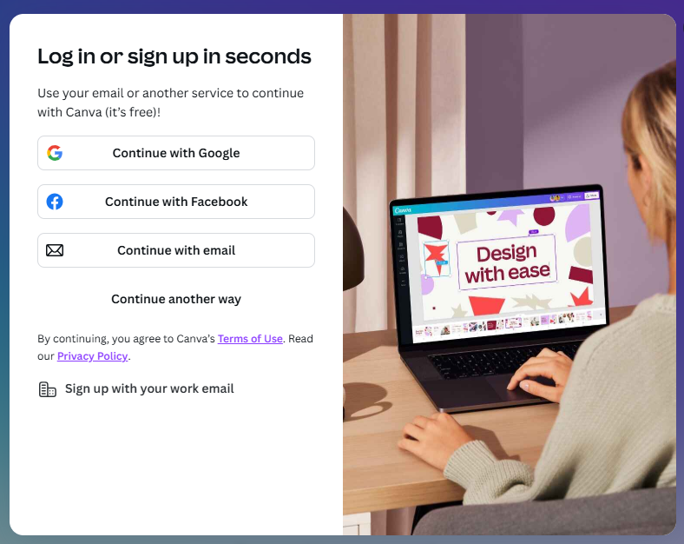
Getting Started with Canva
To sign up to Canva you need to have an email address, phone number or Facebook account to log in.
The first time you go to Canva, you will need to create an account by following the prompts.
Once you have created an account, you can choose to log in next time. You don’t need to create a new account every time.
Notes:
How to Create a Canva Account
Go to the Canva Website. Open your web browser and go to https://www.canva.com.
Click on “Sign up”. On the homepage, click the “Sign up” button (usually at the top right corner).
Choose How You Want to Sign Up. You can sign up using:
Email address
Facebook account
Phone number
If Using Email:
Enter your name, email address, and create a password.
Click “Get started” or “Sign up”.
Verify Your Email. Canva will send a confirmation email. Open your email inbox, find the email from Canva, and click the verification link.
Choose Your Account Type. Canva will ask what you’re using it for (e.g., personal, business, education). Select the one that fits you best.
Start Designing! You’ll be taken to your Canva dashboard where you can start creating designs.

Slide 9
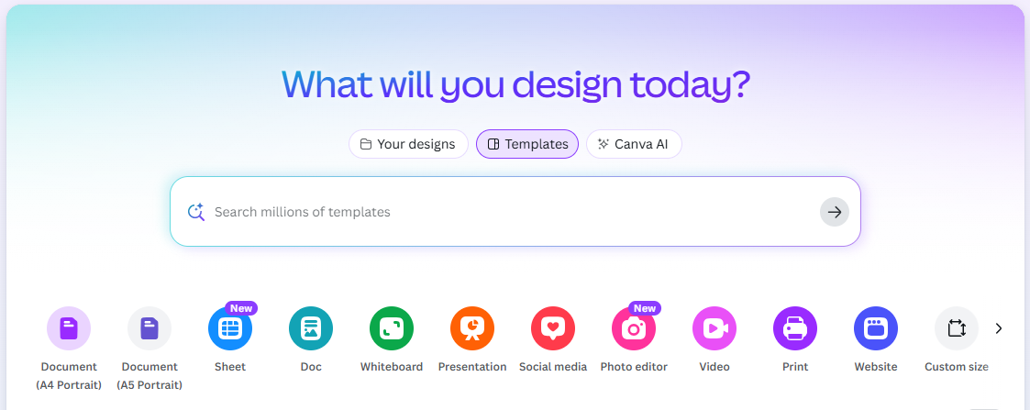

Canva Templates
Canva has a library of templates you can use for free.
Some templates are for ‘Pro’ paid subscriptions only, check for the crown symbol.
You can search for templates with key words such as:
  Instagram post.
  Resume
  Flyer
  Poster
  Booklets
Canva Pro symbol:
This symbol means you need to pay to access this template or design or art
Notes:
One of the reasons Canva is an easy program is that there are hundreds of templates available to use for free.
Once you have created an account and logged into Canva, your home page will show you a search bar. Here is where you can search for a template to use.
Keep an eye out for the ‘Pro’ subscription symbol which looks like the little crown. They are templates you have to pay for.
To start though, there are lots and lots of free templates you can use to get started.
Scroll through the different template options. Remember that you can change anything on the template that you want too, so it doesn’t have to be perfect.
For example, if you found a design for a poster that you like but you want to change the font, you can do that!
A template is like a shortcut to get started, you can still customise it as much as you want. Once you find a template you like, click on it to go to the editing page.
There are 3 main parts of any Canva template, elements, text and images. The next few slides will cover the basics of how to edit them.

Slide 10
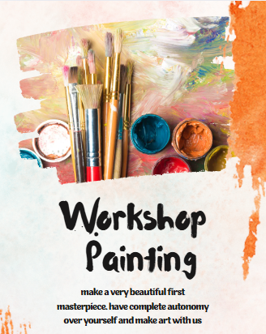
Using different elements
Elements can create unique effects and make your design stand out
The menu on the left hand side of the Canva screen has an Elements section.
Click it to see all the options you can add to your design.
You can change the colour of any elements to whatever you want.
Notes:
Using this poster as an example, the different parts of the poster are:
Elements are Shapes or background decorations, etc (such as the orange paint stroke in the top right corner).
Text: any written words – in this case ‘Workshop Painting’ onwards
Images: any photographs – in this case the image at the top with the paintbrushes and paint pots.
Elements can create all different unique effects.
In this example, the paint brush strokes in orange make the poster a lot more eye-catching than just a photo and text.
From the left-hand menu in the Canva editing page, you can add Elements. The easiest way to find what you are looking for is to search elements.
If you search brush stroke in elements, you will find hundreds of different options. When you find one you like, you can drag it onto the template and drop it where you want it to go.
It doesn’t matter what colour they appear in the search. You can change the colour of any element by clicking on it in the Canva editing screen. When we click on the orange paint in this example, there is an option at the top to change the colour. You can select any colour you want to go with your design.

Slide 11
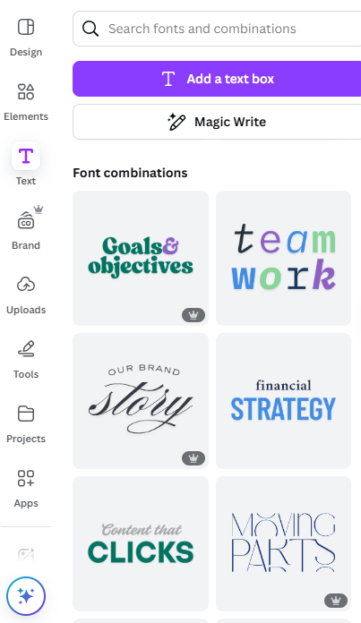
Fonts & Text
Text is added to your template in a text box. These allow you to move or resize your text.
There are lots of options for text in Canva. You can:
  Edit the text in a template to change the words
  Edit the text in a template to change the font style, size or colour
  Add a new text box, or
  Add a new ‘font combination’
Notes:
Once you have a template open in Canva, you can:
add text boxes or edit the text to say what you want,
change the colour or font style,
add a new text box or add a new ‘font combination’.
A font combination (pictured above) is a pre-designed text box. You can add it to your design which includes different texts that work together to create a design. You can use these instead of adding multiple text boxes and using different fonts in each one. They are especially helpful for titles or information you need to stand out.
To edit the text that is already included on the template:
click the words you want to change
you will see them highlighted and you can simply type over them.
You can change this as many times as you want.
If you want to change the font style, size or colour:
click on the text and a menu will pop up at the top that has options for the font style, size, colour and formatting.
You can play around with the different options to see which one best suits your design.
If you want to add more text:
select text in the side menu (circled in red on the slide)
Either:
click the purple box at the top that says Add a text box, or
scroll down and find a font combination you like and click and drag it onto the design.
If you add a text box, it will automatically use the basic font, size and will most often be black font. You can change this by clicking the text box again and using the editing menu that pops up at the top of the screen.

Slide 12
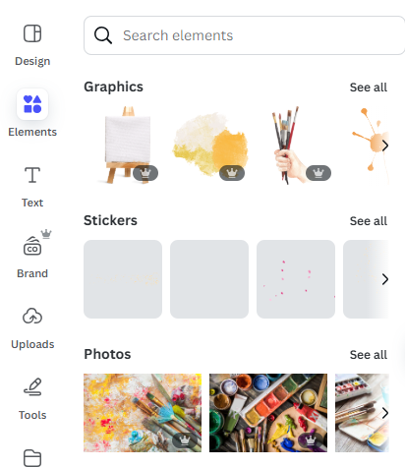
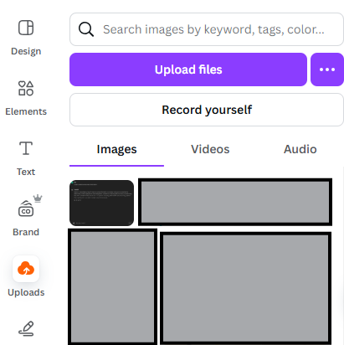
Using images
Using Canva images
Uploading your own image
Notes:
Once you have played around with elements and changed your font, you may want to add or change the pictures.
You can change the picture to one you upload, or Canva also provides lots of free stock photos that you can use. You can even use Canva AI to draw something that you would like.
To upload your own picture, select uploads on the left hand menu. When it opens you will see any previous pictures you uploaded already (instead of the grey boxes on the screen).
When you click the purple Upload files button, you can select photos from the device you are working on.
Once it is uploaded you can drag it and drop it on top of the existing photo and it will replace it.
To change your photo to one of Canva’s free images:
click on the photo box,
go to Elements in the side menu
find the photos section.
You will find that similar photos to the one already in the design will show up first. But you can search for anything you want to find.
Once you find the perfect photo, simply drag it on top of the existing photo so it can replace it.

Slide 13
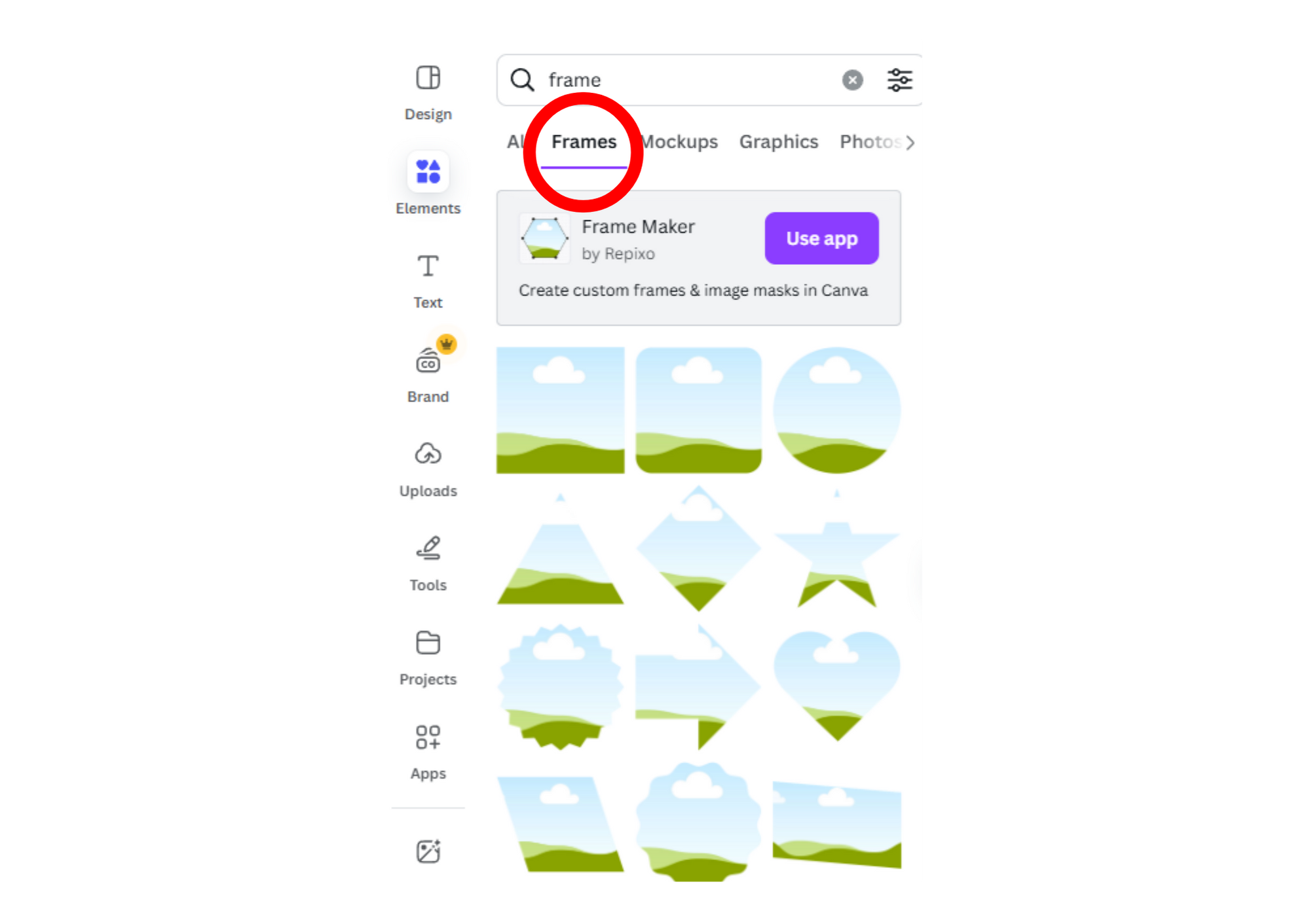
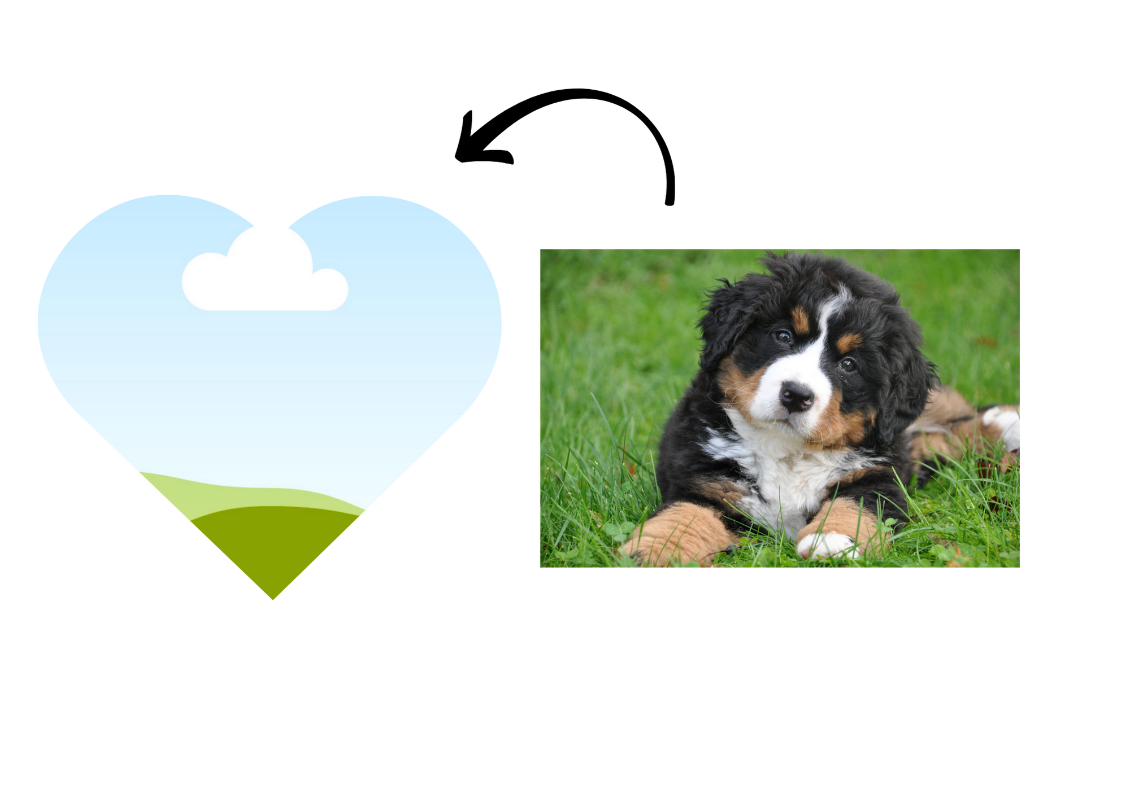

Picture Frames
Just like a picture frame you buy from the shop, you can use picture frames to cut your pictures for display in different shapes.
Add a frame (pictured left) on your design and drag and drop your picture on top of it and it will cut to the size of the frame.
You can adjust the crop/cut by double clicking on it once it is on your design.

Slide 14
Where to get help?
Canva support
Canva has lots of tutorials and guides and videos on the Canva Learn Blog.
Find them here: https://www.canva.com/learn/
You can learn to:
Download
Publish
Add / duplicate pages
AND many more.
Google / AI
You could use Google or AI to help you use the features of Canva.
YouTube has lots of Canva tutorial videos.

Slide 15
Reflection
Intro to Canva and creating an account.
Using templates
Different design elements
Fonts and text
Uploading Photos
Where to get help for Canva
Notes:
Review the main points from today’s session and ask if anyone has any questions.
Remind people to look at the Canva Learn Blog. They have lots of videos and tutorials that explain how to do more complex design in Canva.
Encourage participants to learn more.

Slide 16
Thank you!
Next session time:

Slide 17
Thank you
CRC Champions Program
June 2025

