Slide 1




Digital Skills Training – Passwords and 2 Factor Authentication
CRC Champions Program
2025

Slide 2
Trainer Notes: Passwords & 2FA
Print this handout for participants:
  Passwords
Print a single copy of these slides with the notes section for you to use when presenting
Read:
  through the slides, and make sure you are familiar with the content.
  the handout for participants.
Get in touch with Elliot Elliot@wacoss.org.au before the session if you have any questions.
Remove/hide this slide before presenting and update the time/date of the next session on the final slide.
You can replace any of the pictures with images you have of your community using computers or phones.

Slide 3
Acknowledgement of Country
We know we are on Aboriginal land. We respect Aboriginal people from this land.
Aboriginal people have lived on this land for many years.
We respect all Aboriginal people and their Elders.
We can learn a lot from their stories.
This land always was and always will be Aboriginal land.

Slide 4
Passwords &
2-Factor Authentication
WA Digital Inclusion Project

Slide 5

Session overview
This session will cover:
What passwords are.
How to create a strong password.
Keeping your password safe.
Two Factor Authentication.
Notes:
Greet everyone, introduce yourself and why you’re here.
Explain the workshops purpose. To provide an overview of password safety and two factor authentication.
Highlight the importance of Passwords and 2FA for work, learning and life. Discuss how passwords are needed everywhere and used for many things.

Slide 6

Introductions
Introduce yourself to the group
Share your experience with passwords – did yours change when you learned more?
Notes:
Ask each participant to introduce themselves . They should include their name and one interesting fact about themselves.
Limit each introduction to 30 seconds to keep it brief and engaging.

Slide 7
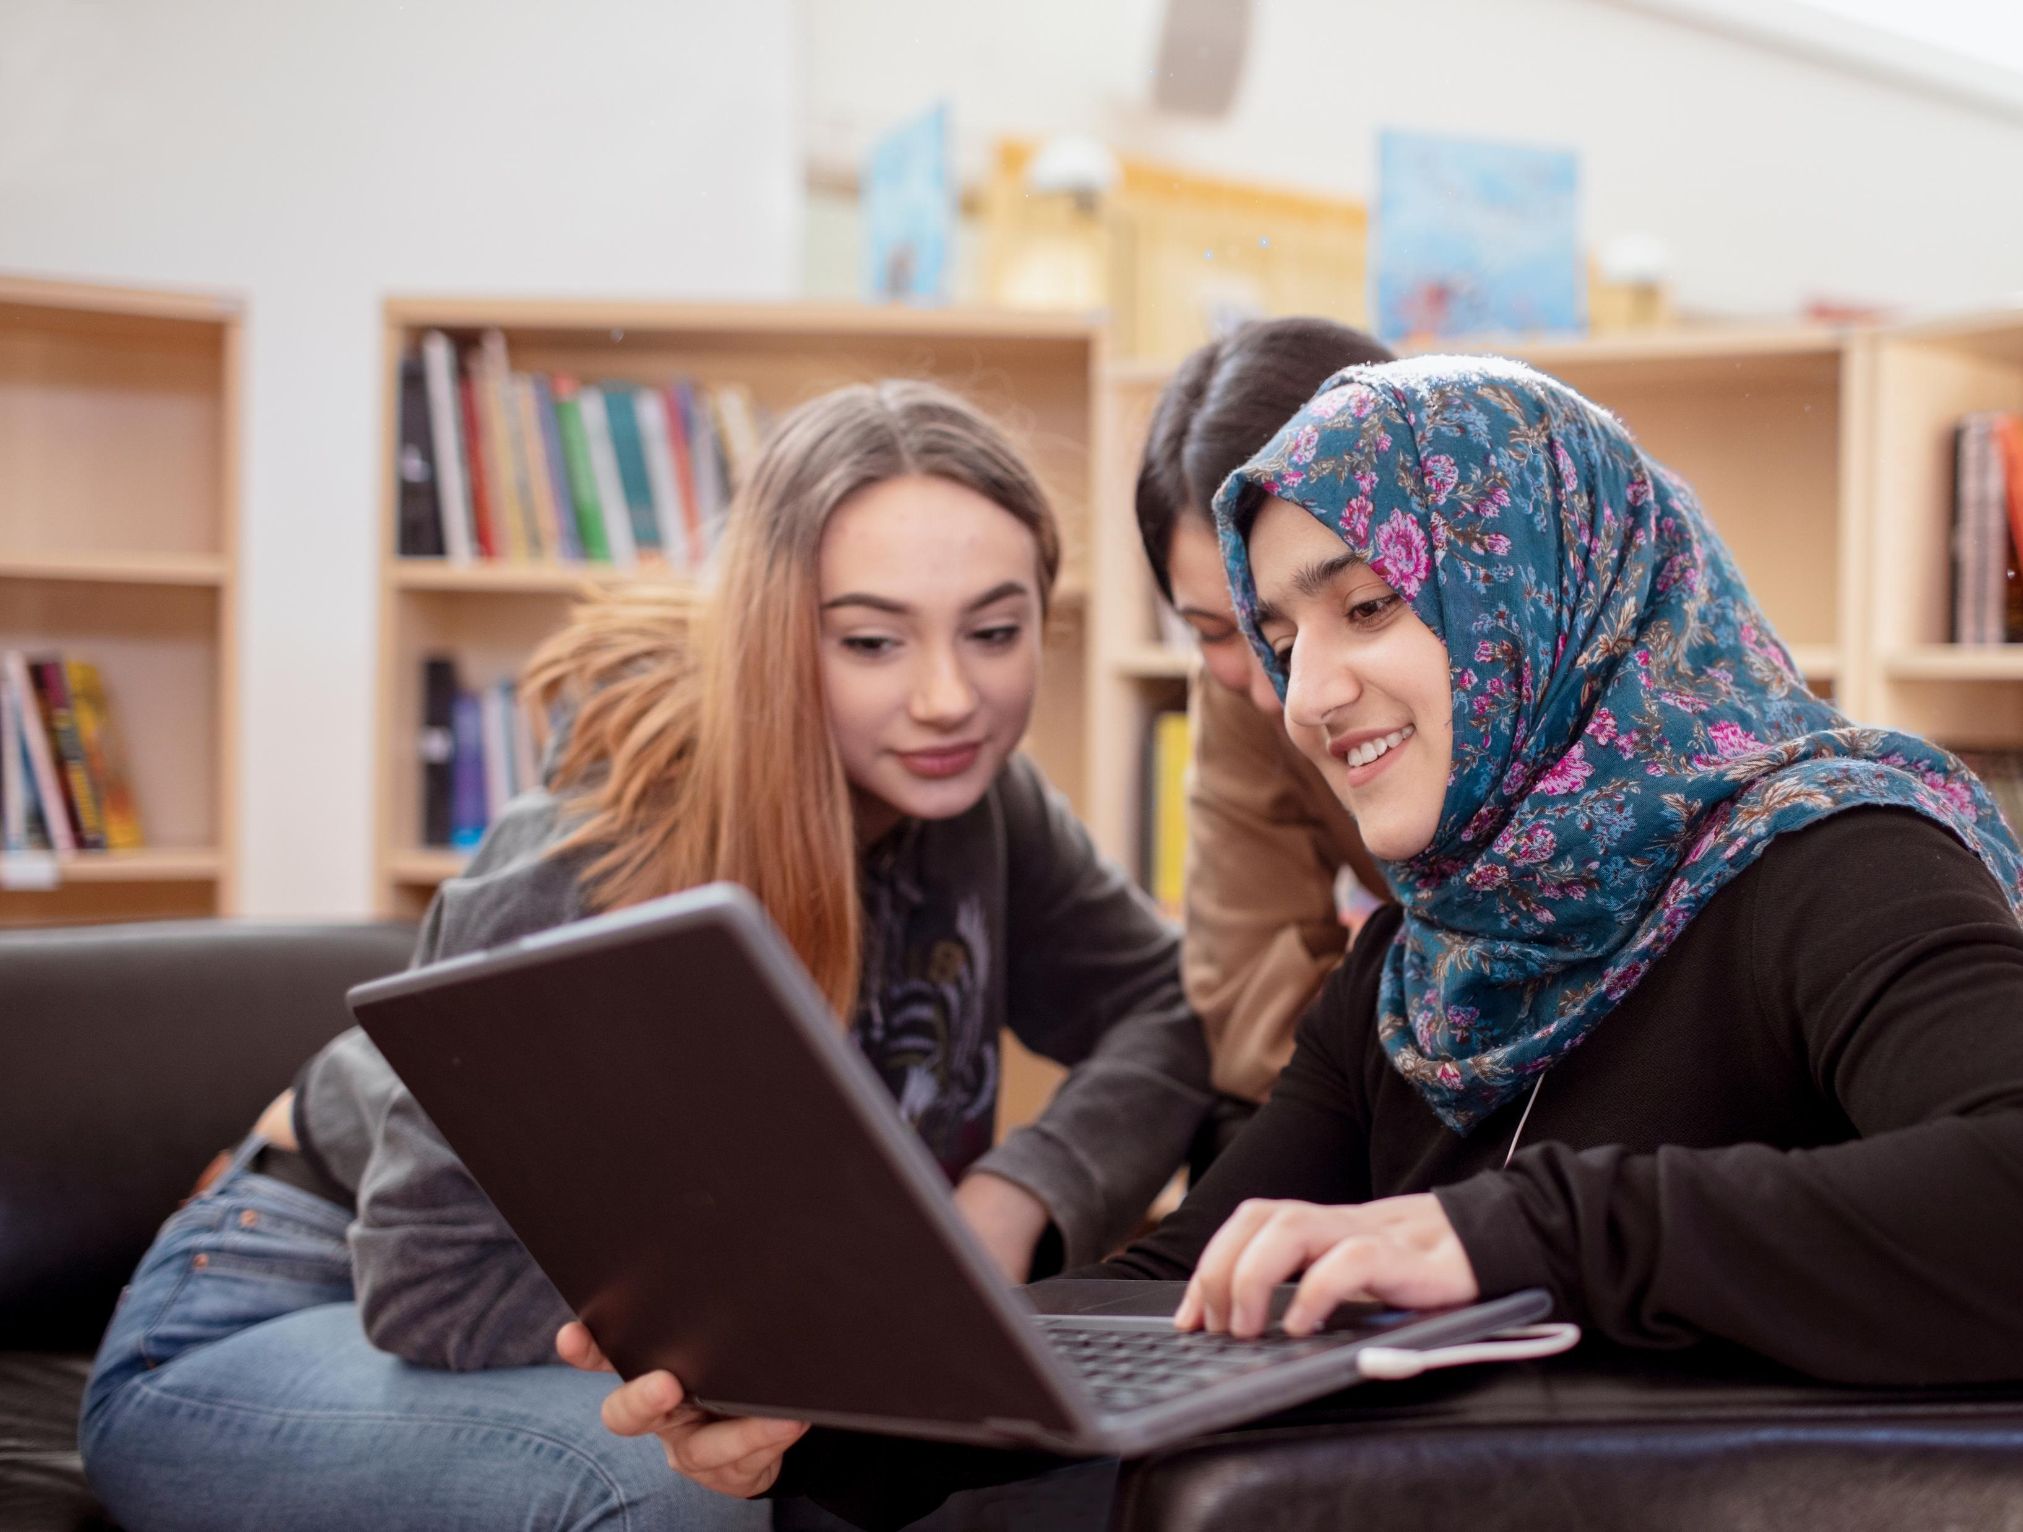
What are passwords?
A password is a secret word or phrase used to protect your online accounts.
It helps keep your personal information safe.
Notes:
Introduction.
Explain what a password is and why it's important for keeping things secure.
Explain that passwords should not be shared.
Interactive Question.
Ask the audience how many of their accounts use passwords?
Ask if they use the same one for different accounts.
Examples.
Show examples of:
weak passwords - "password123“
strong ones - "P@ssw0rd!2025“

Slide 8

Your Special Word?
https://youtu.be/aHaBH4LqGsI?feature=shared&t=55
Watch from 0:55 - 3:42

Slide 9

Creating strong passwords
Use a mix of letters, numbers, and symbols.
Avoid using easy-to-guess information like your name or birthday.
Passphrase: A longer sequence of words that is easy to remember but hard to guess.
Example of a strong password: "Table1Shirt2Flower!"
Example of a passphrase: "SunnyBeach2025!“
Don’t use these example passwords as your own passwords.
Notes:
Explanation.
Explain the importance of using a mix of characters to create strong passwords.
Passphrase.
Introduce the concept of a passphrase.
It is is a longer sequence of words or a sentence that is easy to remember but still secure.
Example.
Show an example of a passphrase like "SunnyBeach2025!"
Explain why it's strong - it combines words with numbers and is easy to remember.
Creating Passphrases.
Choose a few random words that are meaningful to you.
Combine them with numbers or symbols.
Make sure it's long enough to be secure but easy for you to remember.
Activity.
Ask participants to create their own passphrases using the method described.
Encourage people not to share their answers unless they won’t use them!

Slide 10

Tips for Remembering Passwords
Create a story or phrase.
For example, “Thecommunitycentrehasfreewifi" from visiting the local community centre.
Example of a robust password: "C0mmun1tyC#ntr3h@sfreeWiFi"
Notes:
Discuss the ways of creating passwords that are on the screen.
Think of a series of words for a passphrase that no one would be able to guess
The longer the password/passphrase, the harder it is to crack.

Slide 11

Two-Factor Authentication (2FA)
2FA adds an extra layer of security to your accounts.
It requires a second step, like a code sent to your phone, after entering your password.
Notes:
Two factor verification is a second step after your password when you log in to online accounts.
It checks that it really is you trying to log in. Use it for your bank account to help protect it from criminals.
The second step can be:
one time code sent to your mobile phone or email,
a pin number,
a scan of your fingerprint, or
a scan of your face.
Top tip: Set up two factor verification on all your important online accounts.

Slide 12
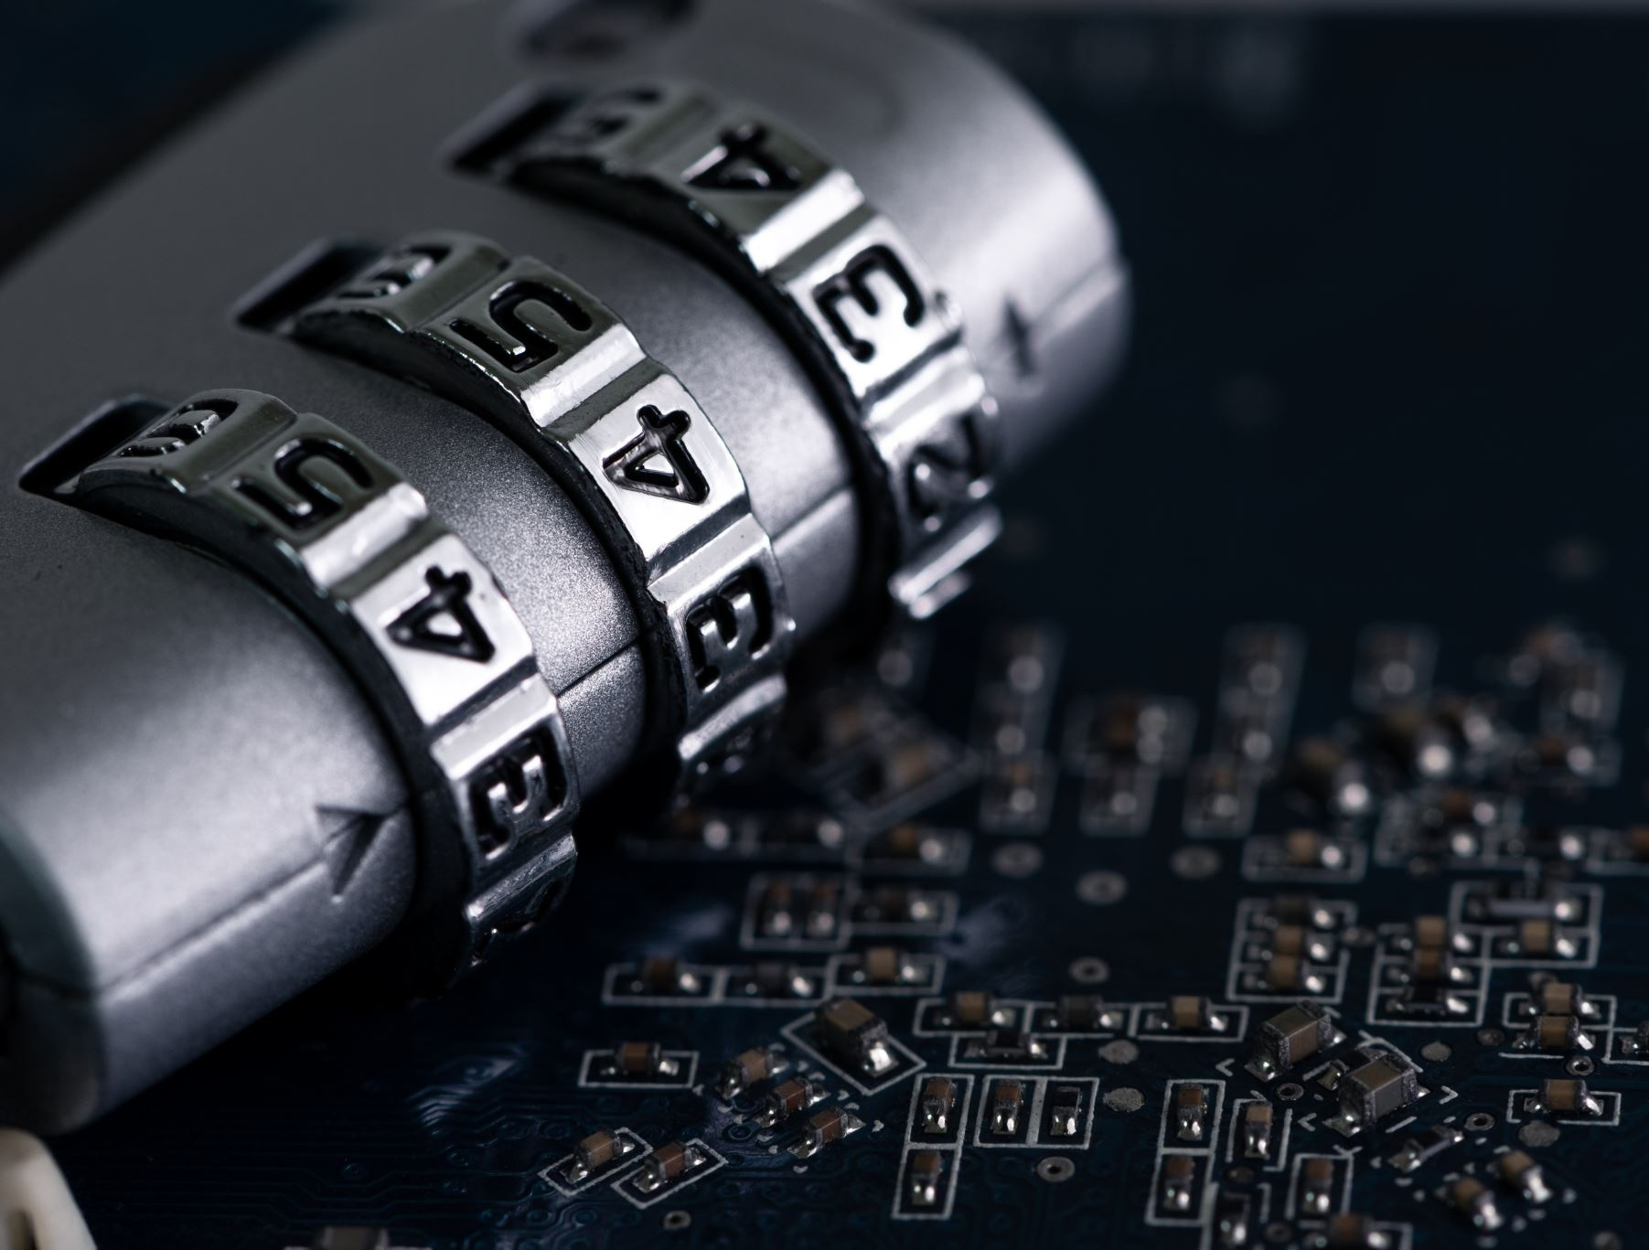
Setting up 2FA
Go to your account settings.
Look for security or 2FA options.
Follow the instructions to set it up.
Notes:
Setting up 2FA on Google
Go to Google Account Settings:
Visit myaccount.google.com.
Sign in with your Google account.
Navigate to Security:
Click on the "Security" tab on the left-hand side.
Set Up 2-Step Verification:
Under the "Signing in to Google" section, find "2-Step Verification" and click on it.
Click "Get Started" and follow the prompts.
Choose Your Verification Method:
You can choose to receive codes via text message or phone call. You can also use an authenticator app like Google Authenticator.
Follow the instructions to complete the setup.
Some banks or other services make 2FA mandatory for some things. For example transferring money to someone you haven’t transferred to for the first time.

Slide 13

Useful resources
Refer to the handout or go to:
https://goodthingsaustralia.org/wp-content/uploads/2024/05/smithfamily_strong_passwords.pdf
https://www.cyber.gov.au/protect-yourself/securing-your-accounts/passphrases
for more information about having strong and safe passwords / passphrases.

Slide 14
Session reflection
This session covered
Strong passwords and 2FA help keep your accounts safe.
Remember to use different passwords for different accounts.
Always enable 2FA when available.
Questions?
Notes:
Reflect using the points on the slide and answer any questions someone might have.

Slide 15
Thank you!
Next session time:

Slide 16
Thank you
CRC Champions Program
February 2025

