Slide 1




Digital Skills Training – Government Services online
CRC Champions Program
2025

Slide 2
Trainer Notes: Government Services
Print these handouts for participants:
    MyGov handout
    Connecting Centrelink to myGov
    ConnectingATO to myGov
    Connecting Medicare to myGov
    Connecting My Health Record to myGov
    Any other linking services you might need from this page
Print a single copy of these slides with the notes section for you to use when presenting.
Read:
    through the slides, and make sure you are familiar with the content
    the handout for participants
Get in touch with Elliot Elliot@wacoss.org.au before the session if you have any questions
Remove/hide this slide before presenting
Update the time/date of the next session on the final slide.
You can replace any of the pictures with images you have of your community using computers or phones.
You know your audience, you may wish to remove the myID section.

Slide 3
Acknowledgement of Country
We know we are on Aboriginal land. We respect Aboriginal people from this land.
Aboriginal people have lived on this land for many years.
We respect all Aboriginal people and their Elders.
We can learn a lot from their stories.
This land always was and always will be Aboriginal land.

Slide 4
Government Services online
WA Digital Inclusion Project

Slide 5

Introductions
Introduce yourself to the group.
Share your experience with government services online.
Notes:
Ask each participant to introduce themselves. They should include their name and one interesting fact about themselves.
Limit each introduction to 30 seconds to keep it brief and engaging.

Slide 6
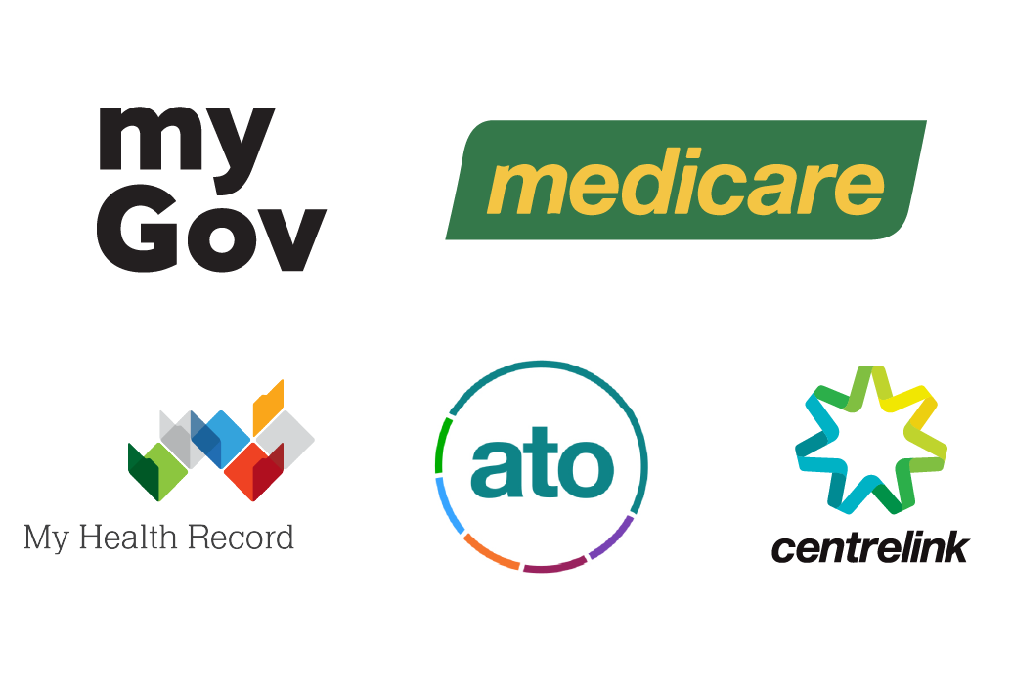

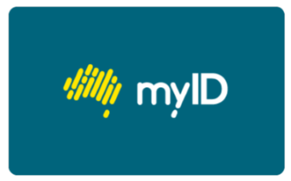
Session overview
This session will cover:
What online government services are, including myGov,
How to create a myGov account,
Linking services to myGov, and
Where to get help if you need it.
Notes:
Greet everyone, introduce yourself and why you’re here.
Explain the workshops purpose. To provide an overview of accessing government services online and two factor authentication.
Highlight the importance of government services online for work, learning and life.

Slide 7
What is myGov?
myGov is a secure way to access government services online.
It allows you to link services like Centrelink, Medicare, and the ATO to your myGov account.
You can then access these services in one place through your myGov login.
Notes:
myGov is a secure way to access government services online. It allows you to link services like Centrelink, Medicare, and the ATO to your myGov account. This means you can access all these services in one place with your myGov login.
Using myGov makes it easier to manage your interactions with different government services. Instead of having multiple logins to remember, you can do everything from one account. This saves time and makes things simpler.
myGov also keeps your personal information safe. With one login, your data is protected by strong security measures. This is important when dealing with sensitive information.
Now, let's think about this: Have you heard of myGov before? If so, what have you used it for?

Slide 8
Creating a myGov account
You’ll need an email address and access to your mobile phone to create a myGov account.
Here are the steps to create a myGov account:
Go to myGov and select Create Account.
Select Continue with Email.
Read the Privacy Notice and Terms of use. If you understand and agree to the Terms of use, select Next.
Enter an Email address and select Next.
Enter the Code sent to your email, then select Next.
Enter your Mobile Number (optional) and select Next.
Enter the Code sent to your mobile phone and select Next.
Enter a Password and then Re-enter password.
Create your 3 Secret questions and answers. Choose from the list or create your own.
More information: https://my.gov.au/en/about/help/mygov-website/create-mygov-account
Notes:
To create a myGov account, you'll need an email address and access to your mobile phone. Here are the steps to follow:
Go to myGov and select Create account.
This is the first step where you start the process.
Select Continue with email.
You'll be using your email to set up the account.
Read the Privacy Notice and Terms of Use. If you understand and agree to the Terms of Use, select Next.
It's important to read and understand these terms before proceeding.
Enter an Email Address and select Next.
Make sure to use an email address you have access to.
Enter the Code sent to your email, then select Next.
Check your email for a code and enter it to verify your email address.
Enter your Mobile Number (optional) and select Next.
You can add your mobile number for additional security.
Enter the Code sent to your mobile phone and select Next.
If you provided a mobile number, you'll receive a code to verify it.
Enter a Password and then Re-enter password.
Choose a strong password and confirm it.
Create your 3 Secret questions and answers. Choose from the list or create your own.
These questions will help secure your account.
For more detailed information, you can visit the myGov help page: myGov Help.

Slide 9

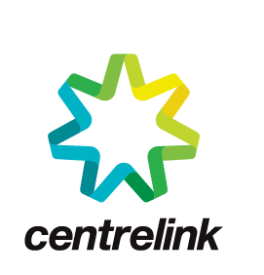



Linking Services
Notes:
Provide an introduction to linking services. Explain the importance of setting up a myGov account to link everything to it.
Why Link Services to myGov?
Easy to Use.
Linking services to your myGov account means you can access them all in one place. No need to remember different logins or websites.
Safe and Secure.
myGov uses strong security to keep your personal information safe.
With one login, you can be sure your data is protected.
Saves Time.
It’s quicker to manage your interactions with government services.
You can:
update your details,
get messages in your myGov Inbox, and
access your accounts from anywhere, even if you’re overseas.
All in One Place.
All important information linked services go to your myGov Inbox, so you won’t miss any updates.
Linking services to your myGov account makes it easier and safer to manage your information and get the support you need.
You should keep you myGov login details private.
Discuss each of the services on the screen or any others that folks may use.

Slide 10
Linking Centrelink to a myGov Account
How you link Centrelink depends whether you have a Customer Reference Number or Not.
Refer to the handout for information about how to connect these or go to:
https://my.gov.au/en/about/help/mygov-website/link-services-to-your-account/link-centrelink
Notes:
Using your Centrelink CRN with myGov:
To use Centrelink with myGov, you need to have what’s called a Customer Reference Number, or CRN for short.
If you already receive any Centrelink payments, you most probably have a CRN ready to go.
To check, you can see if it's on a recent letter or notice you might have received. It's normally displayed somewhere easy to spot.
If you don't have a CRN yet, you may need to go in to a Services Australia office to get it set up first or to help you find your CRN.
If you have a Customer Reference Number:
If you have a Centrelink CRN, you can link Centrelink by either:
answering some questions specific to you; or
using a linking code that was issued to you.
If you’ve claimed a payment before, you’ll have a CRN. You can find your CRN on Centrelink letters, your concession card or in your Centrelink online account.
Follow these steps to link Centrelink to myGov:
Sign in to myGov.
Select View and Link Services.
Select Link on the Centrelink tile.
Select Yes for Do you have or know your Centrelink Customer Reference Number? Select whether you have a linking code. Select Next.
Enter your CRN and your personal details. Select Next.
Enter your payment details and interactions with Centrelink. Select Continue.
If you need more help, go to:
linking Centrelink if you have a CRN, or
linking Centrelink using a linking code
on the Services Australia website.
If you don't have a Customer Reference Number.
If you want to claim a payment or concession, you need a Centrelink Customer Reference Number (CRN).
You need this before you can link Centrelink.
You can get a CRN by proving who you are with Centrelink.
To prove your identity online for Centrelink, you will need to either:
enter details from your identity documents; or
have a strong level Digital ID.
To enter details from your identity documents, you’ll need a Medicare card and two acceptable identity documents.
These identity documents include your:
Australian passport
Australian birth certificate
Australian citizenship certificate
current Australian visa
Australian driver licence
ImmiCard issued by Department of Home Affairs.
Follow these steps to link Centrelink if you don’t have a CRN:
Sign in to myGov.
Select View and link services.
Select Link on the Centrelink tile.
Select No for Do you have or know your Centrelink Customer Reference Number.
Select Get started in Centrelink identity proof. Review the list of accepted identity documents, then select Next.
Read Sharing personal details. Select I understand and agree to the above terms, then select Next.
Enter details from your acceptable identity documents and select Verify. When you’ve verified your identity, select Next.
Enter your Medicare card details and personal details. Select Continue.
If you need more help, go to linking Centrelink using identity verification on the Services Australia website.

Slide 11
Linking Centrelink to a myGov Account
When you link Centrelink to your myGov account you can:
find your Centrelink Reference Number (CRN),
claim a payment,
track your claim,
upload documents,
report your income,
manage your details with Centrelink.
Notes:
Ask people to share any other things they can or have done in Centrelink.

Slide 12
Linking the ato to your myGov Account
Sign into myGov
Click View and Link Services
Select Link next to the ATO
Enter personal details – you might need a Notice of Assessment and your Tax File Number
More information:
https://my.gov.au/en/about/help/mygov-website/link-services-to-your-account/link-the-australian-taxation-office
Notes:
How to link the Australian Taxation Office to your myGov account
Follow these steps to link the ATO to your myGov account:
Sign in to myGov.
Once signed in, go to View and Link Services.
Select Link next to Australian Taxation Office.
Enter or confirm your personal details.
Provide answers to 2 questions to verify your tax record.
Find more information about linking the ATO to your myGov account on the ATO website.

Slide 13
Linking the ato to your myGov Account
When you link your myGov account
to the ATO, you can:
manage your personal and employment details,
view your tax information,
lodge and pay your tax,
view, manage and access your super,
view your student loan balance,
manage your lodgements as a sole trader.

Slide 14
Linking medicare to your myGov Account
You’ll need your Medicare card number.
You’ll need to answer some questions specific to you to link Medicare to myGov.
More information:
https://my.gov.au/en/about/help/mygov-website/link-services-to-your-account/link-medicare

Slide 15
Linking Medicare to your myGov Account
Sign in to myGov.
Select View and Link Services.
Select Link on the Medicare tile.
If your details are already recorded in myGov, they need to match your Medicare record. Select Continue. If you’re linking Medicare for the first time you’ll need to agree to myGov storing your personal details. Select I agree.
You can link Medicare using your Medicare card details or a linking code. Select the best option for you, then select Next.
Enter your Medicare card number and personal details or your linking code. Select Next.

Slide 16
What you can do when you link medicare to myGov
When you link Medicare to your myGov account you can:
make a claim
get a Medicare card
add or remove someone from your Medicare card
update your personal details
view your claim history and statements.

Slide 17
Linking My Health Record to your myGov Account
My Health Record gives you access to key health information, such as:
your COVID-19 information, including vaccinations and pathology in one place
pathology and diagnostic imaging reports
prescription and dispensing information
hospital discharge summaries.

Slide 18
Linking My Health Record to your myGov Account using medicare details
Sign in to myGov.
Select View and link services.
Select Link on the My Health Record tile.
  If you have already linked Medicare, we’ll use your Medicare details to link My Health Record. Select Continue and follow the prompts to link My Health Record.
  If you haven’t already linked Medicare, you’ll need to confirm your identity to link My Health Record.
  Continue with these steps:
Select Use my Medicare record, then select Continue. You’ll need your Medicare card number and to answer some questions specific to you. Select Next.

Slide 19
Linking My Health Record to your myGov Account using Identity Verification Code
If you’re not eligible for Medicare or if you want to verify your identity over the phone, you can use an Identity Verification Code to link My Health Record to your myGov account.
To get a code, contact the My Health Record help line on 1800 723 471.
Follow these steps when you have an Identity Verification Code:
  Sign in to myGov.
  Select View and Link Services.
  Select Link on the My Health Record tile.
  Select Use my access code, then Continue.
  Enter your Identity Verification Code, family name and date of birth. Select Next.

Slide 20
Using My Health Record
You and your healthcare providers can use your My Health Record online to:
view your medicines,
manage your medical information in your record,
get your complete immunisation history statement,
view your pathology and diagnostic imaging reports,
add or update your personal information,
track your child’s development,
get messages sent to your myGov inbox.

Slide 21
myID
A secure way to access myGov with 2-factor authentication
To set up your myID, you need:
a personal smart device. The myID app is compatible with most smart devices, such as smart phones. The app is only available from the Apple App Store or Google Play
a personal email address. As it’s your personal Digital ID, your ID documents will be linked to the email you choose. It should not be a shared or work email address
to be 15 years or older. Age restrictions may also apply to use some government online services.
Notes:
Discuss that to have myID – you need to have your own smart device and it shouldn’t be shared. If you share a phone, you might want to think of another way to log into mygov.

Slide 22
Setting up myID
3 Steps:
Download the myID app on your smart device from App Store (iPhone) or Google Play Store (Android). Don’t download it from anywhere else.
Enter your details.
Choose your identity strength.
Notes:
Three steps to set up myID
1. Download the myID app on your smart device
Only download the myID app from the official app stores listed above.
If you:
are setting up your myID for the first time, continue to step 2
have set up your myID before, select ‘I am an existing user’ and follow the prompts. See Setting up your myID again.
2. Enter your details
Open the myID app on your smart device and follow the prompts to:
enter your email address – choose a personal email you have ongoing access to,
create a password, and
enter your full name and date of birth.
3. Choose your identity strength
You can set up a Basic, Standard or Strong myID.
After entering your details you will have a Basic identity strength.
Increasing your identity strength will better protect your Digital ID and allow you to access more services.
Each online service has a minimum identity strength for access. Check the minimum identity strength needed for the online service you want to use.
The app may ask you to verify an Australian passport or other documents to increase your identity strength. You don’t need to do this if you’ve achieved the minimum identity strength for the online service you want to access.
Once set up, you can use myID as your Digital ID to prove who you are when accessing government online services.
Identity strength
Basic identity strength
A Basic myID allows access to limited participating government online services.
For a Basic identity strength you only need to enter your personal details.
You will be prompted to verify your ID documents. If you choose not to verify your ID documents, or you verify only one document, your identity strength will remain at Basic.
Standard identity strength
A Standard myID allows access to most participating government online services.
For a Standard identity strength, you need to verify your ID with any 2 of the following Australian documents:
passport (an Australian passport, either current or no more than 3 years expired),
driver’s licence or learner’s permit,
birth certificate,
visa (using your foreign passport),
ImmiCard,
citizenship certificate,
Medicare card (this option appears after you verify one of the above documents).
Generally, your name must match on both documents. If you’ve changed your name, you may be able to verify this with a marriage certificate.
You can find support:
to help you verify your ID
if you’re unable to achieve a Standard myID.
Strong identity strength
A Strong myID allows access to all participating government online services.
For a Strong identity strength, you need to:
verify your Australian passport (either current or no more than 3 years expired),
verify one of the following Australian documents:
citizenship certificate,
driver’s licence or learner’s permit, or
Medicare card (this option appears after you verify your passport).
do a face verification check. This is like a selfie that’s compared to the photo on your passport. The app will prompt you on how to do it. It’s a one-off process to check that you’re a real person, the right person and verifying in real time.
Generally, your name must match on both documents. If you’ve changed your name, you may be able to verify this with a marriage certificate.
You can find support:
to help you verify your ID
if you’re unable to achieve a Strong myID.

Slide 23
Using myID
myID and your myGov account are different.
Your myGov account lets you link to and access government services like Medicare and the ATO.
myID is the Australian Government’s Digital ID app. You can use it to sign in to a range of participating government online services, like myGov.
You cannot view your myGov account or Inbox within the myID app.
When you sign in to myGov using your myID app, you’ll enter or accept a 4-digit code in your myID app. This is instead of using your myGov username, password and security codes.
You can use myID to access myGov and then use linked services

Slide 24

Useful resources & more assistance
    MyGov handout
    Connecting Centrelink to myGov
    Connecting ato to myGov
    Connecting medicare to myGov
    Connecting My Health Record to myGov
    Any other linking services you might need from this page

Slide 25
Session reflection
myGov, My Health Record, and myID help you manage your government services and health information online.
Remember to keep your login details secure.
If you use myID, make sure your phone has a password that no one else knows.

Slide 26
Thank you!
Next session time:

Slide 27
Thank you
CRC Champions Program
2025

