Slide 1



Digital Skills Training – Online Forms
Community Champions Program
2025

Slide 2
Trainer Notes: Completing Online Forms
Print this handout for participants:
  Online Forms
Print a single copy of these slides with the notes section for you to use when presenting
Read:
  through the slides, and make sure you are familiar with the content.
  the handout for participants.
Get in touch with Elliot Elliot@wacoss.org.au before the session if you have any questions.
Remove/hide this slide before presenting and update the time/date of the next session on the final slide.
You can replace any of the pictures with images you have of your community using computers or phones.

Slide 3
Acknowledgement of Country
We know we are on Aboriginal land. We respect Aboriginal people from this land.
Aboriginal people have lived on this land for many years.
We respect all Aboriginal people and their Elders.
We can learn a lot from their stories.
This land always was and always will be Aboriginal land.

Slide 4
Online forms
WA Digital Inclusion Project

Slide 5
Session overview
By the end of this session you will be able to understand:
What online forms are,
Where you might find an online form, and
How to complete an online form.
Notes:
Greet everyone, introduce yourself and why you’re here.
Explain the workshops purpose. Provide an overview of what will be covered in the session.
Highlight the importance of forms for work, learning and life.
Discuss how online forms are everywhere and used for many things.

Slide 6

Introductions
Introduce yourself to the group
Share your experience with online forms – where have you seen them used before and what have you used them for?
Notes:
Ask each participant to introduce themselves. They should include their name and one interesting fact about themselves.
Limit each introduction to 30 seconds to keep it brief and engaging.

Slide 7

Online forms
Digital versions of paper forms
Apply for or use services
Shop online
Fill in surveys
Provide information for subscriptions
Notes:
Online forms are digital versions of paper forms. They are used for:
applying for services,
online shopping,
filling in surveys, or
providing information for subscriptions.
These forms help collect information online, like contact details or orders.
They are easier to access and track compared to paper forms. Yet, for people who are not familiar with using the internet, online forms can be challenging.
As more services go online, it's important to know how to use these forms to engage with them.
This is especially useful for:
applying for government services,
online shopping, or
participating in surveys.
We will go through the steps together to make it more manageable for everyone.

Slide 8
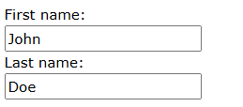
Parts of online forms
Textboxes:
For information like names, addresses etc.
Notes:
Text boxes are used for entering free-form text.
There are single-line boxes for short information like names.
There are also multi-line boxes for longer information like comments.
How to Use: Click inside the text box to place the cursor, then type your information. If you're using a screen reader, it will announce the text box and any associated label.

Slide 9
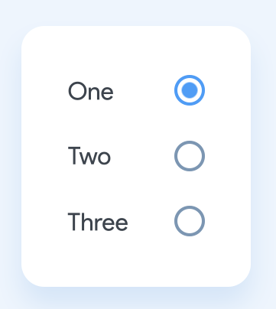
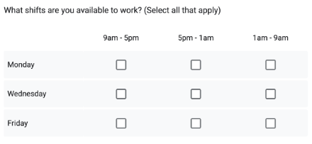
Radio Buttons and Check Boxes
Radio Buttons
Check boxes
When you can only select one item in a list
When you can select more than one option
Notes:
Radio buttons allow users to select one option from a list of predefined choices.
How to Use: Click on the circle next to the option you want to select. Only one option can be selected at a time. If you're using a screen reader, it will announce the radio button group and each option.
Check boxes allow users to select one or more options from a list. They are often used for multiple-choice questions or to agree to terms and conditions.
How to Use: Click inside the small square box to select an option. You can select multiple check boxes if needed. If you're using a screen reader, it will announce the check box and its label.

Slide 10
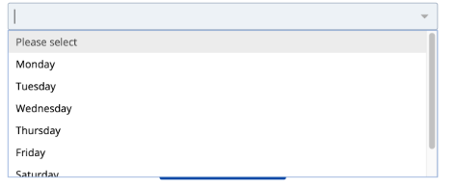
Drop-down lists
When you can only select one item from a drop-down list
Notes:
Drop-down lists allow users to select one option from a list of predefined choices. They help keep forms concise and organised.
How to Use: Click on the arrow next to the drop-down list to see the available options. Click on an option to select it. If you're using a screen reader, it will announce the drop-down list and each option.

Slide 11

Handy Hints
Asterisk (*) = compulsory
Suggested text and auto-complete
Some forms have a time limit
Uploading documents
Notes:
Provide tips and explain each point.
Boxes marked with an asterisk (*) are compulsory. This means you have to complete that section to submit a form.
Sometimes when you are typing in a textbox your computer or smartphone may suggest what to type. This is called auto-complete. Make sure it’s correct before you accept its suggestion.
There may be a time limit. Get all items ready before you start.
Some forms will ask you to upload a document, like your CV. There will often be instructions in the form you can follow to do this.
Ask people to share their own tips

Slide 12

Completing and submitting
Submit and Confirm: Don’t forget to click the Submit and Confirm buttons when you’ve finished the form.
Saving a Copy: Some forms allow you to print or save a copy for your records.
Corrections: If you make a mistake, many forms will highlight the error and ask you to correct it before submitting again.
Back Button: Use the form’s Back button to return to a previous page, not your browser’s back button.
Notes:
Explain the process of submitting and correcting online forms.

Slide 13

Useful resources
Refer to the handout or go to
https://goodthingsaustralia.org/learn-resource/smith-family-online-forms/
For more information about how to complete online forms

Slide 14
Session reflection
Have you got any questions?
Do you have an understanding of what online forms are?
Where might you find an online form?
Do you know how to complete an online form?
Notes:
Reflect using the questions and answer any questions someone might have.

Slide 15
Thank you!
Next session time:

Slide 16
Thank you
Community Champions Program

