Slide 1



Digital Skills Training - Email
Community Champions Program
2025

Slide 2
Trainer Notes: How to email
Print this handout for participants:
  Sending emails
Print a single copy of these slides with the notes section for you to use when presenting
Read
  through the slides, and make sure you are familiar with the content
  The handout for participants
Get in touch with Elliot Elliot@wacoss.org.au before the session if you have any questions
Remove/hide this slide before presenting and update the time/date of the next session on the final slide.

Slide 3
Acknowledgement of Country
We know we are on Aboriginal land. We respect Aboriginal people from this land.
Aboriginal people have lived on this land for many years.
We respect all Aboriginal people and their Elders.
We can learn a lot from their stories.
This land always was and always will be Aboriginal land.

Slide 4
Email
WA Digital Inclusion Project

Slide 5
Session overview
This session will cover:
What is email and what it can be used for
Setting up an email account
Using email
Being safe with email
Notes:
Greet everyone, introduce yourself and why you’re here.
Discuss the uses beyond sending and receiving email like letters in the post. For example, your email can be your username for services.
It is important that when you create an email account it is:
memorable for you to access and use the email address, and
secure because it will include personal information and allow access to other accounts.
Include that you will be talking about how to access and use email safely. Remind them to attend future training about online safety.

Slide 6

Introductions
Introduce yourself to the group
Share your experience with email – have you got an email address and what have you used it for?
Notes:
Ask each participant to introduce themselves. They should include their name and one interesting fact about themselves.
Limit each introduction to 30 seconds to keep it brief and engaging.

Slide 7



What is email?
Send and receive messages
Attach files
Personal and work use
Sign in to services
Notes:
Ask participants, “What do you know about email? Has anyone used email before?” – get participants to share their experiences.
Email is a tool that lets you send and receive messages over the internet. It's like sending a letter, but much faster.
With email, you can:
Send and receive messages quickly.
Attach files like photos or documents.
Organise your messages to keep things tidy.
Use it for both personal and work communication.
Emails are also useful for signing in to different services. Many websites and apps need an email address to create an account. This includes:
Government services like MyGov for Medicare and Centrelink.
Online banking to manage your money.
Shopping websites to track orders.
Social media like Facebook and Instagram.
Having an email address helps you access these services and stay connected.

Slide 8
Email Service Providers
Choosing an Email Provider: Options include Gmail, Outlook, and Yahoo.
Creating a New Email Account: Select a unique username and a strong password
Notes:
Different email providers are Gmail, Outlook, and Yahoo. Each of these providers has its own features and benefits.
Gmail is provided by Google.
It's very popular.
It offers a lot of storage space.
It works well with other Google services. For example Google Drive and Google Calendar.
It also has powerful search capabilities and excellent spam filtering.
Outlook is provided by Microsoft.
It's known for being user-friendly.
It works well with Office 365 and OneDrive.
It also has great calendar features and strong security.
Yahoo Mail has been around for a long time and is known for being simple. It offers:
customisable themes,
a large storage space, and
built-in news and weather updates.
When creating a new email account, it is important to keep your account secure by:
Choosing a unique username, and
a strong password.
Here are some tips for creating a strong password:
Make it long. Aim for at least 12 characters. Longer passwords are harder to crack.
Use a mix of characters. Include letters (both uppercase and lowercase), numbers, and special characters.
Avoid common words and phrases. Don't use easily guessed information like "password" or "123456".
Consider a passphrase. Use a series of random words strung together, like "BlueSkyElephantTree".
To sign up for these email services, you can visit:
Gmail: mail.google.com
Outlook: outlook.com
Yahoo: mail.yahoo.com
To sign up, you need to put in your name and create an email address. Everyone will see the name you put when you email them!

Slide 9
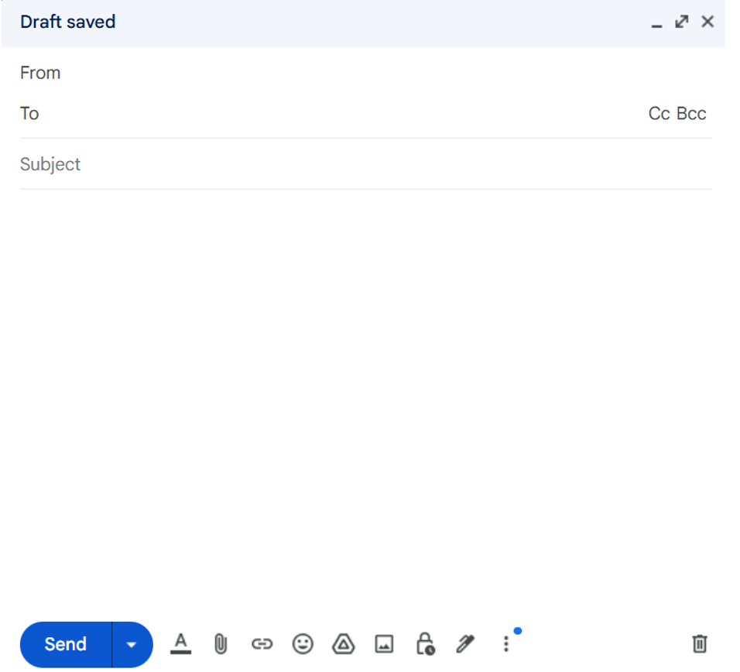

Writing emails
New Message
digitalinclusion@wacoss.org.au
you@youremail.com
Reminder: digital skills workshop - email
Dear [friend]
I hope this email finds you well.
This is a friendly reminder that we have a Digital Skills workshop coming up about email. In this workshop, we will cover how to set up an email account, how to write and reply to emails, and how to stay safe online with emails.
If you have any questions, please contact me at digitalinclusion@wacoss.org.au
I hope to see you there
Elliot
Senior Training and Project Officer
WA Digital Inclusion Project
Notes:
Run through the following parts of an email.
Compose Button:
This button is used to start writing a new email. Click on it to open a new email window.
From:
This shows who is sending the email. It will be your email address.
To:
This is where you type the email address of the person you want to send the email to.
CC/BCC:
CC stands for "Carbon Copy". Use this to send the email to other people who should see it, but are not the main recipient.
BCC stands for "Blind Carbon Copy". Use this to send the email to other people without the main recipient knowing.
Subject:
This is a short line that tells the recipient what the email is about. Keep it clear and to the point.
Body:
This is where you write your message. Start with a greeting, write your main message, and end with a closing.
Send Button:
Click this button to send your email to the recipient.
Discard Button:
Click this button if you want to delete the email draft and start over.

Slide 10



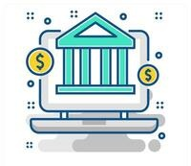



Using your email address
Sign in to various services
  Government services (MyGov)
  Online banking
  Shopping websites
  Social media
Use different passwords for each service
Keep passwords long and strong
Notes:
myGov: A secure way to access services online.
There are a lot of government services to keep track of - health, tax, pension, and more.
It's easy to forget something in all those piles of paper.
MyGov gives you a way to organise all of that securely online, with a single login and one password.
myGov keeps correspondence secure.
There can be lots of important information to read when it comes to government services.
The myGov website keeps all these records safe in your myGov Inbox.
They will let you know when a new letter or message has been received, so you won't miss anything.
myGov is free.
To use myGov, all you need to do is set up a free myGov account.
You can then link your different services to your newly created myGov account.
We'll explain how to do this, but it's very simple and secure.

Slide 11

Be careful with email
Phishing emails
Fake emails to steal information
Look real but are scams
Don't click on suspicious links
Don't share personal info
Report phishing emails
Notes:
Phishing is when someone sends you a fake email to try and steal your personal information. These emails often look real and might seem like they come from a bank, a company, or even a friend, but they are scams.
Here are some tips to protect yourself from phishing:
Don't click on suspicious links. If an email looks strange or asks you to click on a link, be careful. It might take you to a fake website that looks real.
Don't share personal information. Never give out your passwords, bank details, or other personal information in response to an email.
Look for signs of phishing. Phishing emails often have:
spelling mistakes,
generic greetings like "Dear Customer," and
urgent messages that try to make you act quickly.
Report phishing emails: If you get a phishing email, report it to your email provider or a relevant authority.
By being aware of phishing, you can avoid falling for scams.

Slide 12

Phishing Scams
What are the signs that this is a fake email?
Notes:
Look at the email on the screen and see if you can find the red flags with this email received?
The next slide has the answers, but see if people can find some of the signs before showing them.

Slide 13


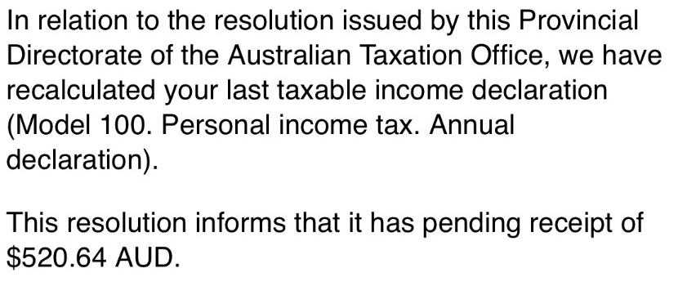
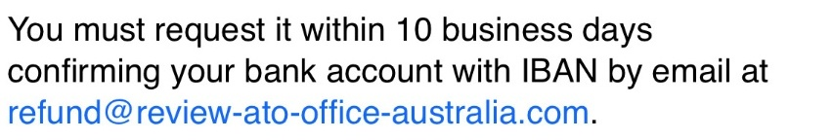
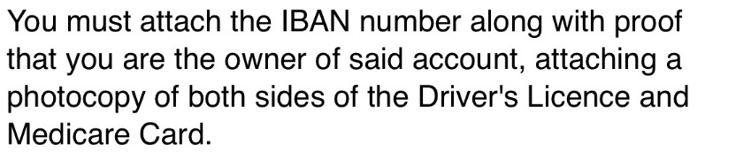
Not a government email address
This sounds too good to be true. Contact the ATO or check MyGov to see if they owe you money.
Logo copied from ATO website
Asking for you to send 100 points of ID. The government would never ask for this information by email!
Creating a sense of urgency
Notes:
The email address is not a Government legitimate email address.
They use confusing language with complicated words.
It sounds too good to be true – they are saying you are owed $520.64
They are trying to rush you to acting in 10 business days. If the Government owes you money, there is no time limit like this.
They are asking you to send an IBAN (International Bank Account Number). It is also another email address that doesn’t look legitimate.
They are asking you to send 100 points of ID (Medicare card & Driver’s Licence). With this information they could steal your identity.

Slide 14

Reflection
What is email and what it can be used for
Setting up an email account
Using email
Being safe with email (phishing!)
Notes:
Review the main points from today’s session and ask if anyone has any questions.
Share some of people’s experiences with Email.

Slide 15
Thank you!

Slide 16
Thank you
Community Champions Program

