Slide 1




Digital Skills - eSafety & Online Resources
CRC Champions Program
2025

Slide 2
Acknowledgement of Country
We know we are on Aboriginal land. We respect Aboriginal people from this land.
Aboriginal people have lived on this land for many years.
We respect all Aboriginal people and their Elders.
We can learn a lot from their stories.
This land always was and always will be Aboriginal land.

Slide 3
Session Overview
Today, we will cover:
Understand eSafety.
  Learn what eSafety is and why it's important.
Recognise and Respond to Scams.
  Identify six common scams, and
  Learn how to stay safe online, including creating strong passwords and reporting phishing.
Access Resources
  Discover digital upskilling resources and helpful links for further learning.
Notes:
Greet everyone, introduce yourself and why you’re here.
Explain the workshop’s purpose.
To provide an overview of how to access and use technology safely including:
identifying scams,
what to do if you have been scammed, and
where to go for further reliable information about staying safe online.

Slide 4
eSafety
WA Digital Inclusion Project

Slide 5

What is eSafety?
Notes:
Brainstorm what eSafety is – and how trainers could discuss this with their community.
Being safe online:
being aware of scams,
developing skills to identify when something is not right,
and what to do when this happens.
Making sure to avoid language like dangerous and scared.
We want participants to feel knowledgeable and alert for scams – not scared.

Slide 6






Types of Scams
Investment Scams
Remote Access & Hacking Scams
Online Shopping Scams
Phishing Scams
Romance Scams
Gift Card Scams
Source: NBN Scam Awareness Resources
Notes:
Start by giving an overview of the different types of scams that exist.

Slide 7
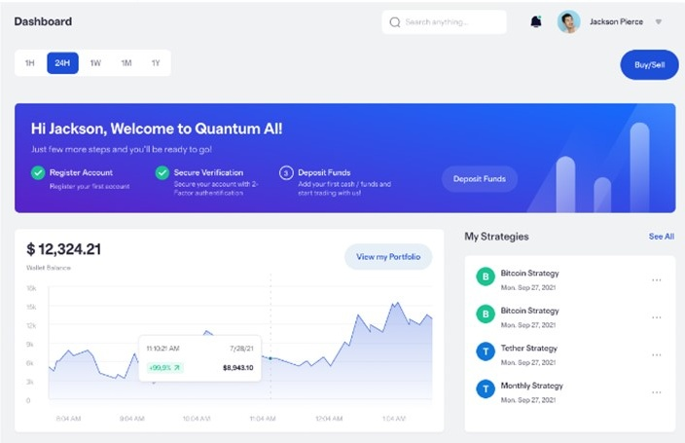
Investment Scams
Scammers try to convince you to invest money.
They say you will get lots of money back with no (or very low) risks.
They may even have very convincing websites showing your ‘investment’.
Notes:
Investment Scams:
Scammers try to convince you to invest money.
They say you will get lots of money back with no (or very low) risks.
They may even have very convincing websites showing your ‘investment’.

Slide 8
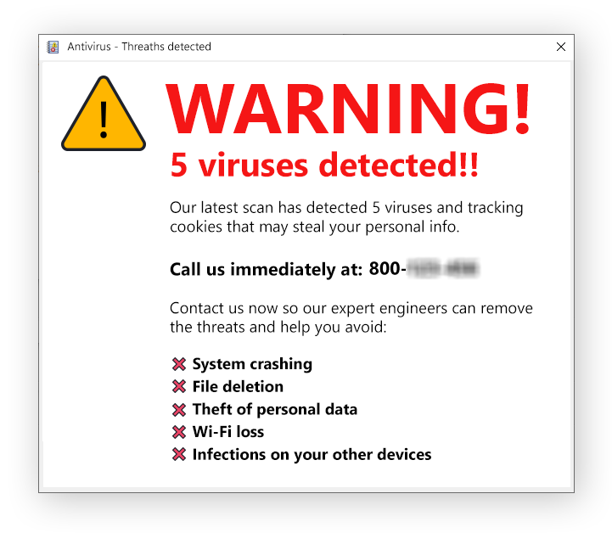
Remote Access & Hacking Scams
Scammers will call you or send you an email to contact you.
They will ask you to download something, usually pretending to 'fix' your computer.
This allows them to access your device to steal information saved it.
Notes:
Remote access scams & hacking scams:
Scammers will call you or send you an email to contact you.
Scammers will ask you to download something, usually pretending to 'fix' your computer.
This allows scammers to access your device to steal information saved it.

Slide 9

Online Shopping Scams
Scammers create fake ads or websites selling products.
They will take your money and never provide you with the product.
Notes:
Online shopping scams:
Scammers create fake ads or websites selling products.
Scammers will take your money and never provide you with the product.

Slide 10

Phishing Scams
Scammers send fake emails from someone like the bank or Government.
They will usually ask you to send them personal information.
Once they have enough details, they can pretend to be you.
Notes:
Phishing Scams:
Scammers send fake emails from someone like the bank or Government.
They will usually ask you to send them personal information.
Once they have enough details, they can pretend to be you.

Slide 11

Romance Scams
When a scammer takes advantage of people looking for love online.
They often pretend to have feelings for you and then ask you for money once you trust them.
If you are using dating apps or websites, make sure you confirm someone’s identity, in person where possible.
Notes:
Romance scams:
When a scammer takes advantage of people looking for love online.
Scammers often pretend to have feelings for you and then ask you for money once you trust them.
There is no shame in telling someone that you:
cannot give them money, or
that you think you have been scammed!

Slide 12
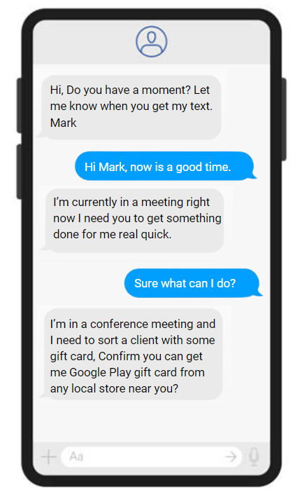
Gift Card Scams
Scams involve someone convincing you to buy gift cards and provide them with the details.
Scammers often pose as legitimate businesses, government agencies, or even someone you know.
They might claim that payment via gift cards is needed to resolve an issue or to help in an emergency.
Notes:
Gift Card Scams:
When people ask for you to pay a bill or a fine with a gift card, this is often a scam
Scammers pretend to be legitimate; do not pay a fine/government bill/toll with a gift card!

Slide 13
Tips to stay safe online
Beware of suspicious phone calls.
Be cautious with texts you receive.
Make your passwords strong.
Be careful on Social Media.
Trust your gut!
Notes:
Tip 1 - If someone calls you and asks for personal information:
Take down their details and hang up. You can say “I didn’t ask you to call me, so I am going to hang up the phone now”
Find their real number from their website. Call them back on it.
Tip 2 - Be Cautious with Texts and Emails
If a text or email seems strange or requests money:
Call your friend or family member on the number you already have for them. Ask them to verify the information.
Tip 3- Strengthen Your Passwords:
Make your passwords long and hard to guess.
Don’t use your name or words like 'password’.
Combine uppercase, lowercase, numbers, and special characters.
Tip 4 - Be Mindful of What You Share on Social Media:
Think twice before posting personal details online.
Check photos don’t have personal information in them accidentally.
Tip 5 - Trust Your Gut:
Don’t click on suspicious links.
Be cautious with unknown contacts online.
Stay vigilant and follow your intuition.

Slide 14
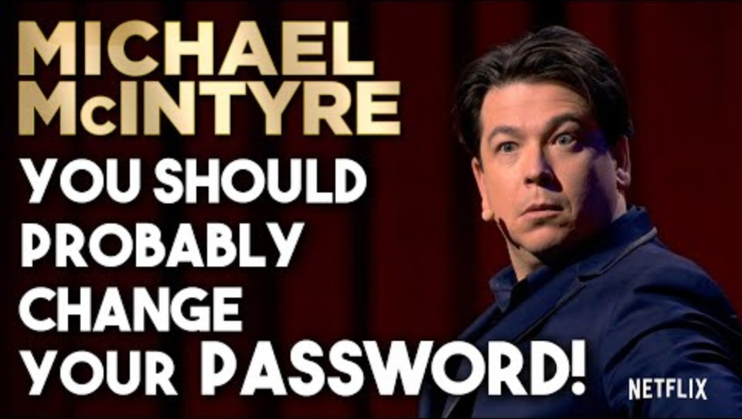
Your Special Word?
https://youtu.be/aHaBH4LqGsI?feature=shared&t=55
Watch from 0:55 - 3:42

Slide 15
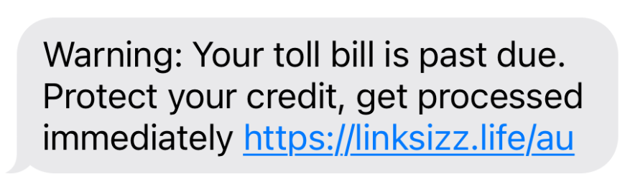

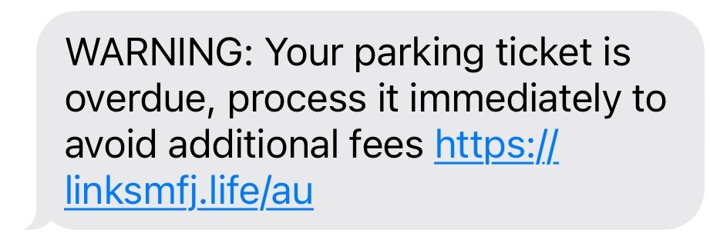
Scam Test!
Which one of these do you think is real?
Notes:
Ask the group which one they think is real and why?
The next slide will give them the answer!

Slide 16
Scam Test!
Which one of these do you think is real?
This is the real message, and we can verify in other ways! We don’t need to click links in SMS

Slide 17
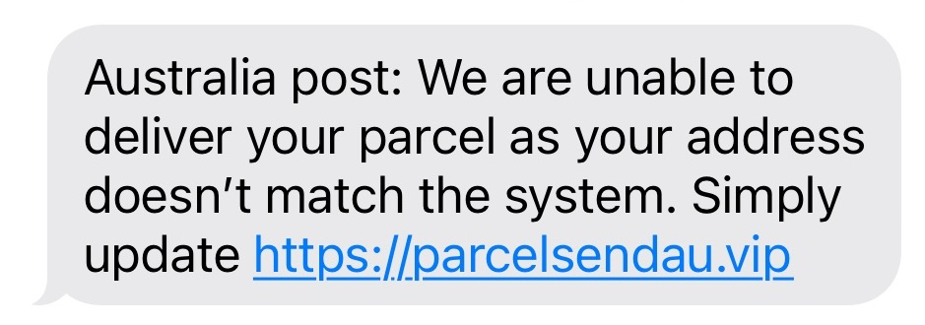
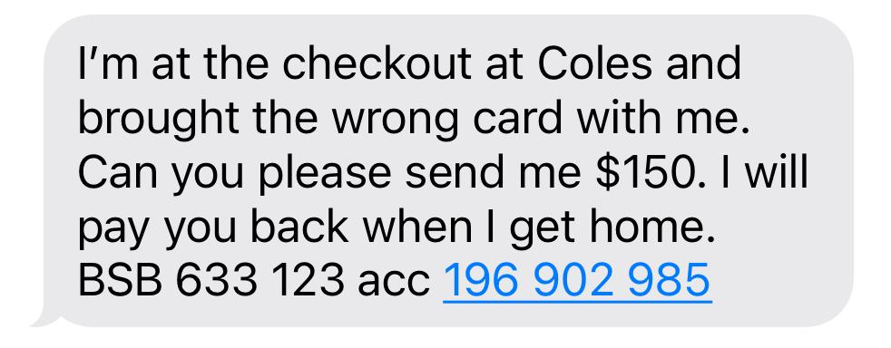
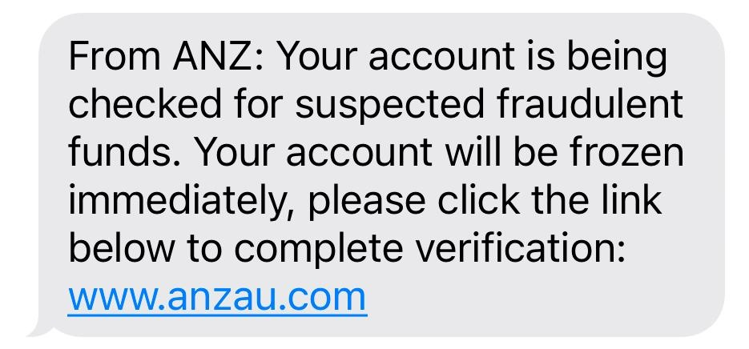
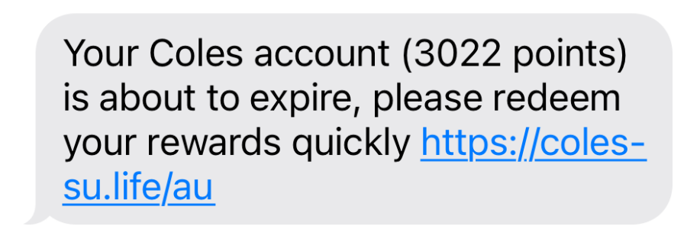
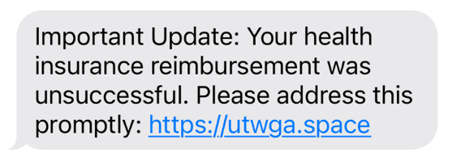
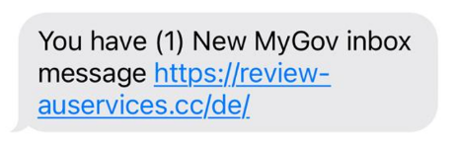
SMS Scams – More examples!
Notes:
Read through the messages.
Remember that scammers might:
Try to rush you or create a sense of urgency.
Pressure you by threatening your credit or fees of some sort.
To be safe, always:
Pause and verify before acting
Always double-check messages and avoid clicking suspicious looking links.

Slide 18
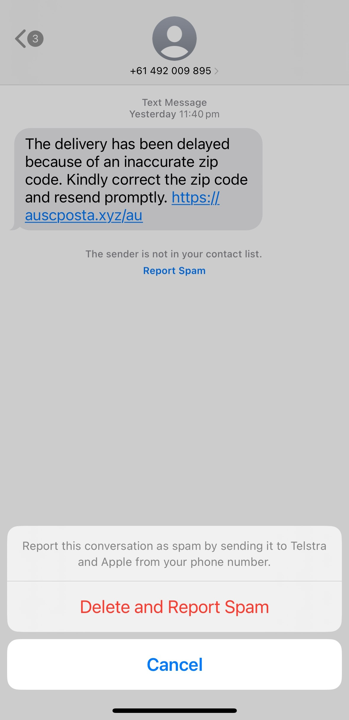
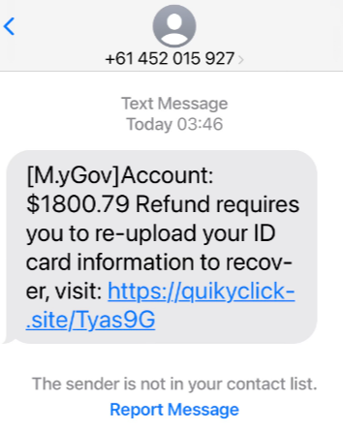
Spam text? iPhone
On iPhones, you can report messages as spam, and they are deleted from your phone.
Notes:
On an iPhone, to report a spam text:
Open the message.
Tap “Report Spam” below the spam text message.
Tap “Delete and Report Spam”. This will remove the text from your phone and send the information to Apple and your phone service.

Slide 19
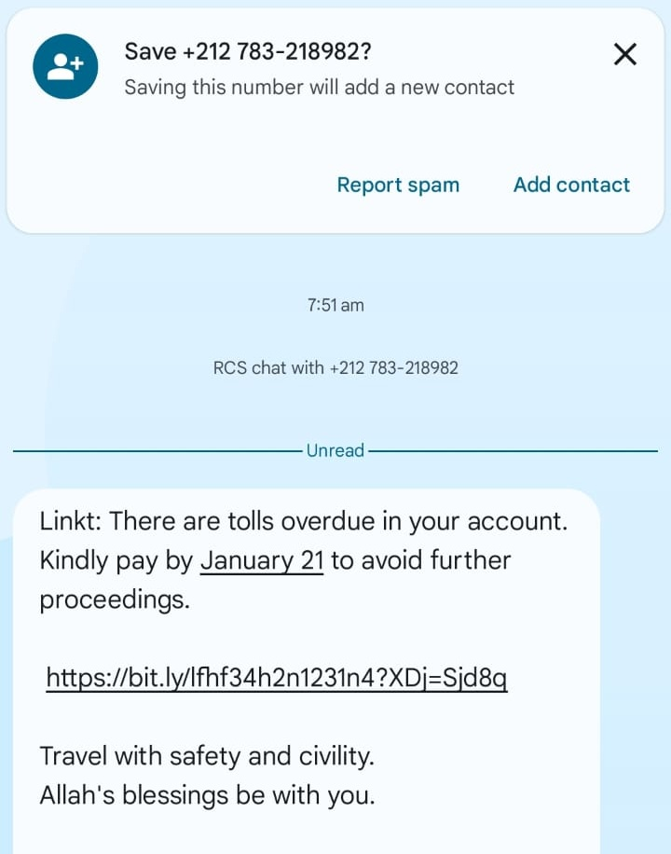
Spam text? Android
On Android, click ‘Report scam’ to:
Block the number from contacting you again.
Move the message to your Spam folder.
Notes:
On an android, to report a spam text:
Open the message.
Tap “Report scam” in the menu.
This will remove the text from your phone and send the information to Apple and your phone service.

Slide 20
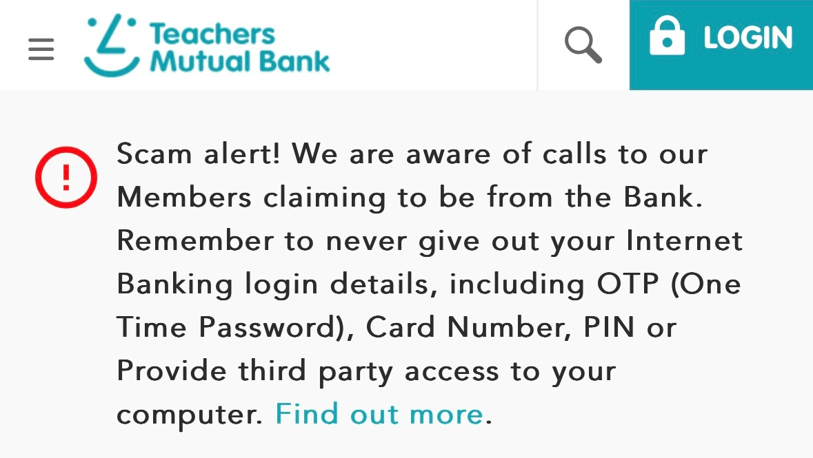
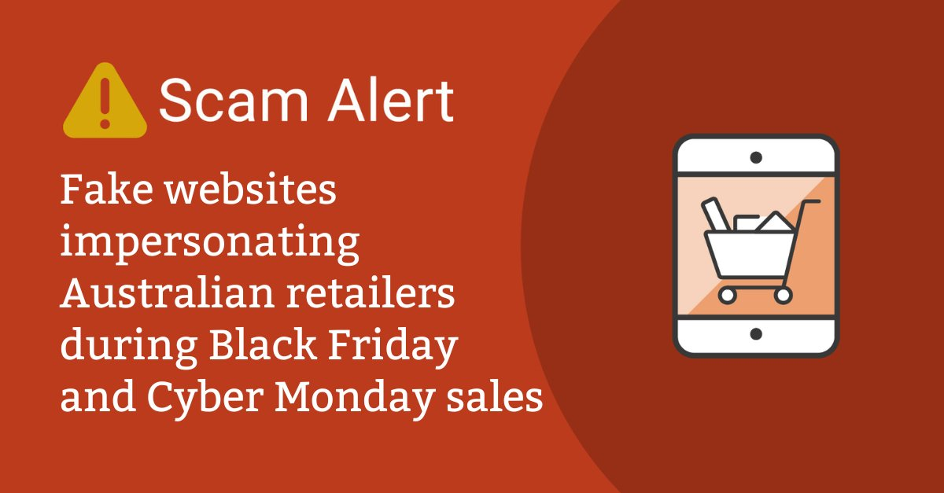
Company warnings
Notes:
This is an example of one bank warning their customers on their website and banking app.
Most banks will say:
Never share your one-time pin or password (the code you might get by text message when logging in to an account)
Don’t share your full card number, usually they will only ask for the last 4 to 6 digits.
Never give out your online banking details, including your password.
Never give anyone your card’s pin number.
Other websites also do this.
The second example is warning people about fake online Australian stores.
The Government created this warning because of Scammers.
Scammers were making fake websites. These websites replicated the real ones very well.
They used them to advertise Black Friday sales.
If you bought something from them, they took your money. Usually, you never got anything delivered.

Slide 21

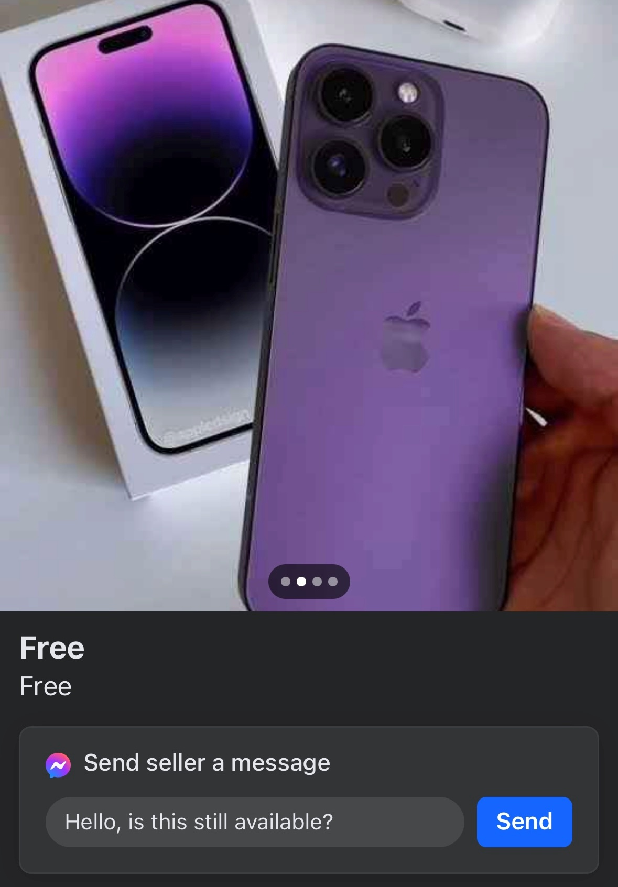
Marketplace
Scams
Notes:
Lots of scams are out there on Facebook Marketplace.
In these examples, both are advertising expensive items at cheap prices.
When you message them, they asked for a deposit to ‘hold’ the item until the end of the day. Even when you ask to pick up straight away they may ask for a deposit.
One of these even gave a real address for pick up – it was a house listed for sale online that was empty.
When the buyer refuses to give a deposit, they will often block you and disappear.
Other times on Marketplace people might:
Ask you to pay with a gift card. They cannot be traced if you get scammed. Never pay with a gift card.
Ask you to move to a different platform like WhatsApp or texting, or to pay via Bank Transfer. Always stay on Marketplace to talk so if anything goes wrong Facebook can help you.
Create fake ads for items that don’t exist or advertise holiday rentals. They entice people with low prices and ask for a ‘deposit’. If you pay, they might block you and disappear.
Create ads for fake items. The item might exist but they might say it is a real brand that is expensive, like Gucci. When you get the item, it will be a fake that isn’t worth the money you paid for it.
To stay safe on Marketplace, remember to:
Collect the item in person and pay cash where possible.
Never give people your own PayID or bank details if you are selling something. They can get a lot of information from your PayID.
Trust your gut. If it sounds too good to be true, it probably is.

Slide 22

Scam red flags
The Contact
They will generally contact you first by phone, text or email.
They often impersonate organisations or businesses to seem legitimate.
The Story
They will have a convincing story to hook you into the scam.
The Urgency
Scammers will pressure you to take action quickly so you don’t have time to realise something is wrong.
They often include fake deadlines or ‘limited time’ offers.
Notes:
Start by overviewing the anatomy of a scam.
There are 3 key parts to most scams.

Slide 23



If you think you’ve been scammed
Contact
your bank or the company straight away
Report
to Scamwatch online
Call
IDCARE on 1800 595 160 if you've given a scammer your personal details
Notes:
If you might have been scammed:
Contact: your bank or the service provider straight away.
Report: to Scamwatch online.
Scamwatch is run by the Australian Government.
They take scam reports and learn from them to try to reduce scams in the future.
Call: IDCARE on 1800 595 160 if you think your identity information has been stolen.
They will not charge you and they will help you secure your information.

Slide 24
Where to find help to get and stay safe online
WA Digital Inclusion Project

Slide 25
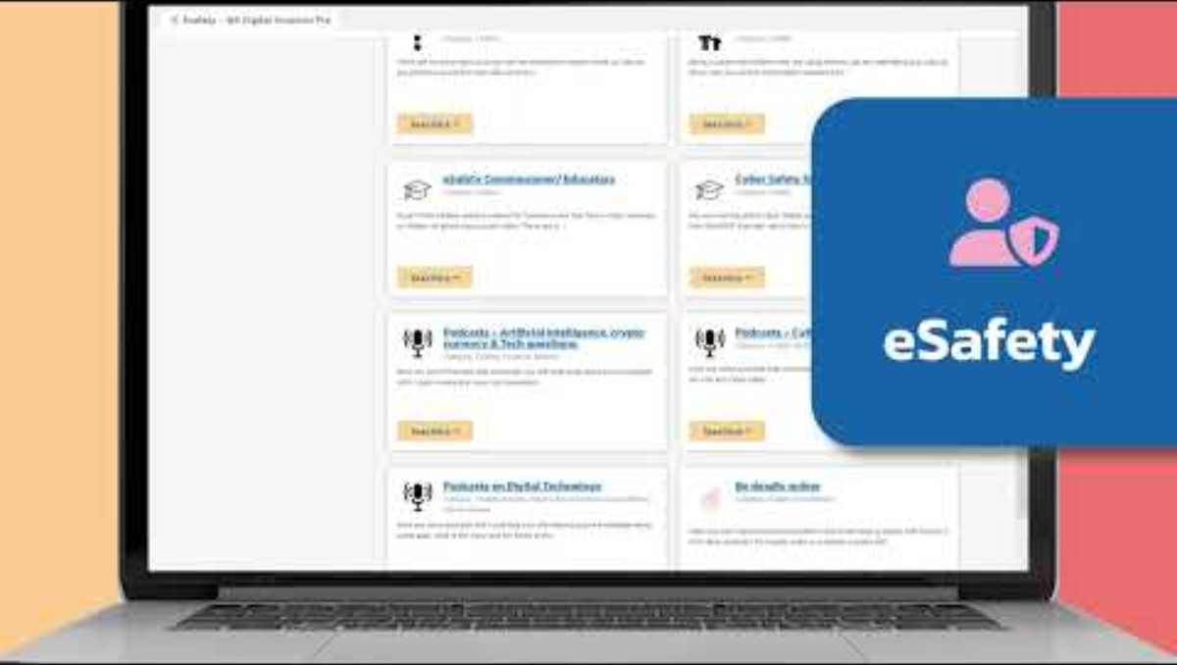
The WA Digital Inclusion Project

Slide 26





Helpful Links
https://digitalinclusionwa.org.au/learn
https://www.esafety.gov.au/
https://www.scamwatch.gov.au/types-of-scams
https://www.nbnco.com.au/learn/protect-yourself-from-scams
Notes:
For more information on eSafety, go to:
The Digital inclusion website: https://digitalinclusionwa.org.au/learn
The eSafety Commissioner website: https://www.esafety.gov.au/
The Scamwatch website: https://www.scamwatch.gov.au/types-of-scams
The NBN website: https://www.nbnco.com.au/learn/protect-yourself-from-scams
These website addresses are in the participant’s booklets for them.

Slide 27
Session Objectives - Review
Understand eSafety.
  Learn what eSafety is and why it's important.
Recognise and Respond to Scams.
  Identify six common scams, and
  Learn how to stay safe online, including creating strong passwords and reporting phishing.
Access Resources.
  Discover digital upskilling resources and helpful links for further learning.
Notes:
Review the information from the presentation.
Make sure that everyone feels a level of confidence in being and staying safe online.
Make sure they know where to go for further help or information about scams and safety online.

Slide 28
Thank you!
February 2025

