Slide 1



Digital Skills Training - Smartphones
Community Champions Program
2025

Slide 2
Trainer Notes: Introduction to a smart phone
Print these handouts for participants:
  Getting setup with your smart phone (Android)
  Getting setup with your smart phone (iPhone)
Print a single copy of these slides with the notes section for you to use when presenting.
Read:
  Through the slides, and make sure you are familiar with the content,
  The handout for participants.
Get in touch with Elliot Elliot@wacoss.org.au before the session if you have any questions.
Remove/hide this slide before presenting and update the time/date of the next session on the final slide.

Slide 3
Acknowledgement of Country
We know we are on Aboriginal land. We respect Aboriginal people from this land.
Aboriginal people have lived on this land for many years.
We respect all Aboriginal people and their Elders.
We can learn a lot from their stories.
This land always was and always will be Aboriginal land.

Slide 4
Introduction to a smart phone
WA Digital Inclusion Project

Slide 5
Session overview
This session will cover:
Understand the basic functions of a smartphone.
Learn what a smartphone is and its main uses.
Get started with your smartphone.
Learn how to charge, turn on, and set up your smartphone.
Navigate and use your smartphone safely.
Learn how to use basic features and stay safe online.
Notes:
Greet everyone, introduce yourself.
Explain the workshop’s purpose – to provide an overview of how to use a smart phone.
Highlight the importance of using a phone for education, life and work.
Include that you will be talking about how to use a smart phone safely.
Remind them to attend future training to learn more about the safety of using a phone.

Slide 6

Introductions
Introduce yourself to the group.
Tell them one interesting fact that they might not know about you!
Notes:
Quick Introductions
Aim: To quickly get to know each other and create a friendly atmosphere.
Ask each participant to introduce themselves. They should include their name and one interesting fact about themselves.
Limit each introduction to 30 seconds to keep it brief and engaging.
After everyone has introduced themselves, comment on anything that stood out.

Slide 7
Understanding Smart Phones
Watch this video:
https://vimeo.com/879269983
What is a smart phone and what might you use one for?
Notes:
Here are some questions you could ask after the video.
Understanding Smartphones:
"What did you think about the video?”
“Did it help you understand what a smartphone is?"
Opportunity for Sharing:
"Let's take a few minutes for anyone who wants to share their experiences with smartphones.”
”Have you used one before?
“What was it like?"

Slide 8
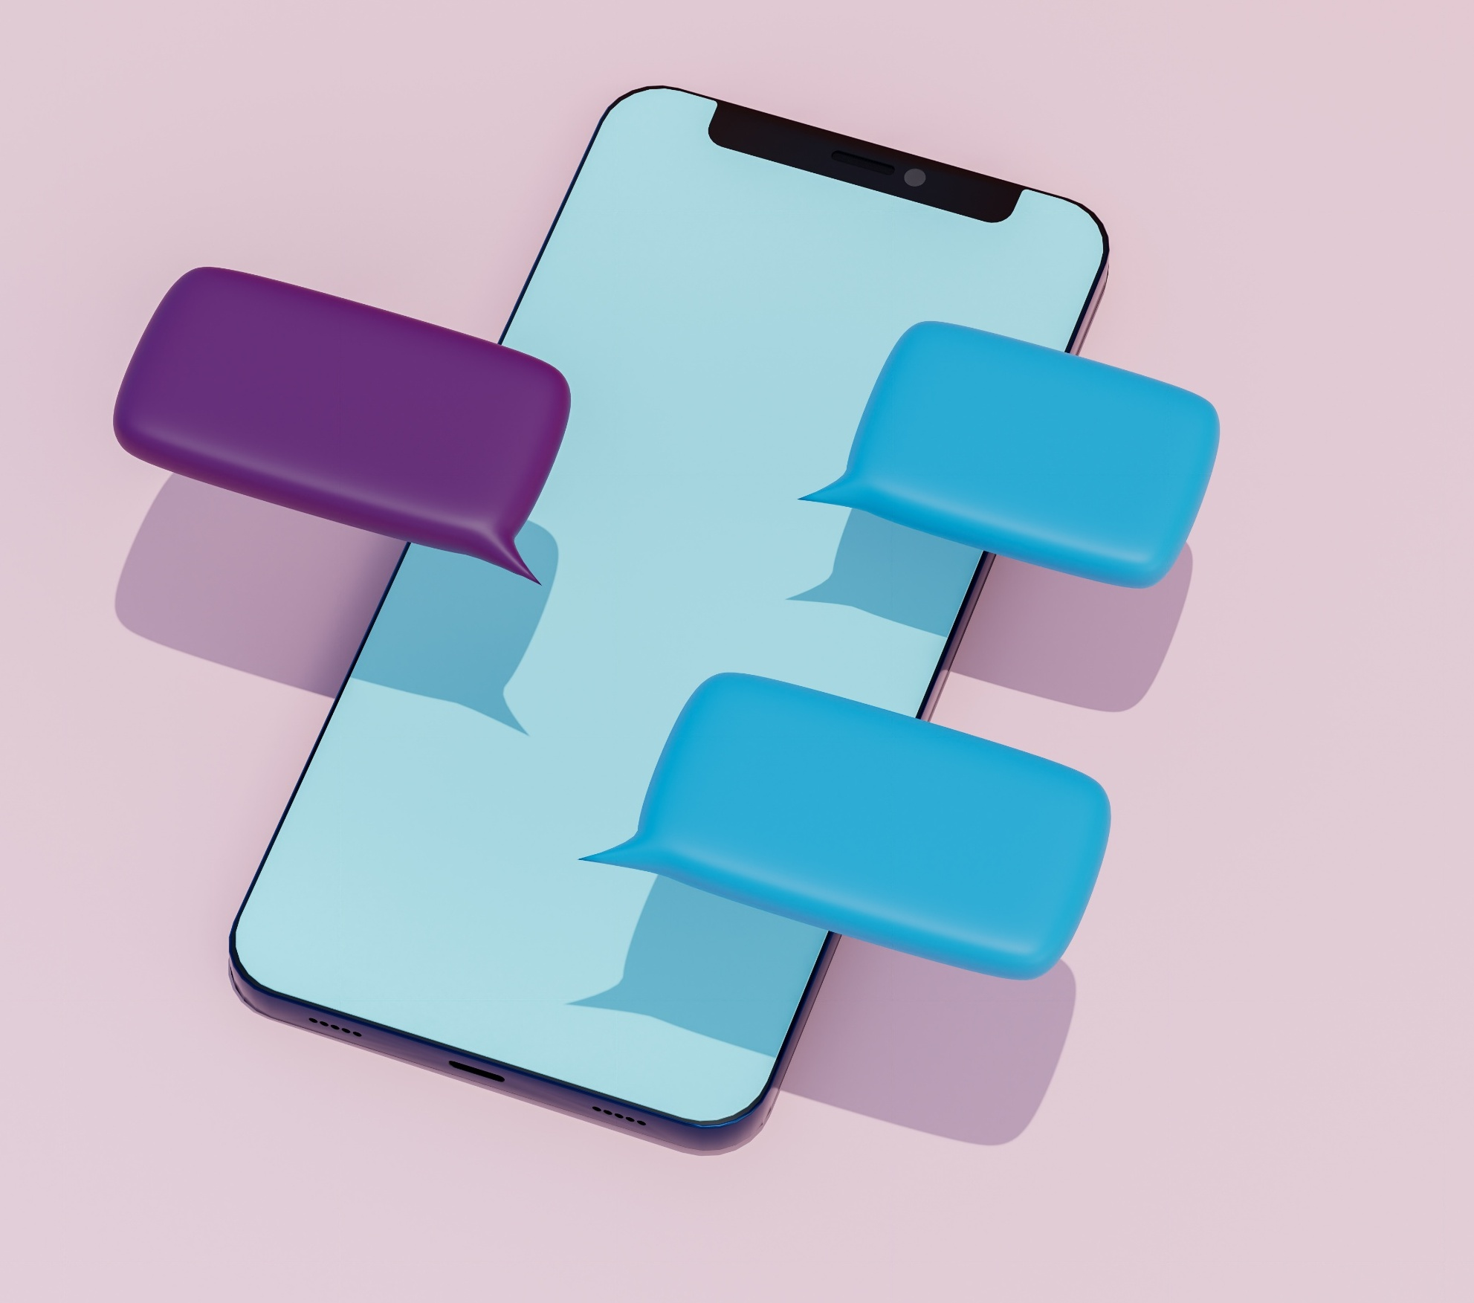
Getting started with a smart phone
Charging your smart phone
Turning on your smart phone
Setting up your phone
Getting setup with your smart phone (Android)
Getting setup with your smart phone (iPhone)
Notes:
Charging Your Smartphone:
Start with charging your smartphone.
Every smartphone comes with a charger.
To charge your phone, plug the charger into a power outlet and connect the other end to your phone.
You'll usually see a battery icon on the screen showing that it's charging.
It might take a few hours to fully charge, depending on how low the battery is.
It's a good idea to charge your phone overnight or whenever you're not using it for a while.
Anyone with a smartphone, look for the battery indicator at the top of your screen.
Turning On Your Smartphone:
Next, talk about turning on your smartphone.
To turn it on, press and hold the power button until you see the screen light up.
The power button is usually on the side or top of the phone.
If the phone doesn't turn on, it might need to be charged first.
Once the phone is on, you'll see the home screen or a welcome screen if it's the first time you're using it.
Setting Up Your Phone:
When you turn on your phone for the first time, you'll need to set it up.
This usually involves:
selecting your language,
connecting to Wi-Fi, and
signing in with your Google or Apple account.
Follow the on-screen instructions to complete the setup. If you don't have a Google or Apple account, you can create one during the setup process.
Getting Setup with Your Smartphone (Android):
For Android phones, the setup process will guide you through:
connecting to Wi-Fi,
signing in with your Google account, and
setting up security features like a PIN or fingerprint.
You'll also have the option to restore data from a previous phone if you have a backup.
Once the setup is complete, you'll see the home screen with various app icons.
Getting Setup with Your Smartphone (iPhone):
For iPhones, the setup process will guide you through:
connecting to Wi-Fi,
signing in with your Apple ID, and
setting up security features like Face ID or Touch ID.
You'll also have the option to restore data from a previous iPhone if you have a backup.
Once the setup is complete, you'll see the home screen with various app icons.
Interactive Activity:
Take a few minutes to go through the handouts that you printed.
Make sure people have at least a copy of the one that looks like their phone.

Slide 9
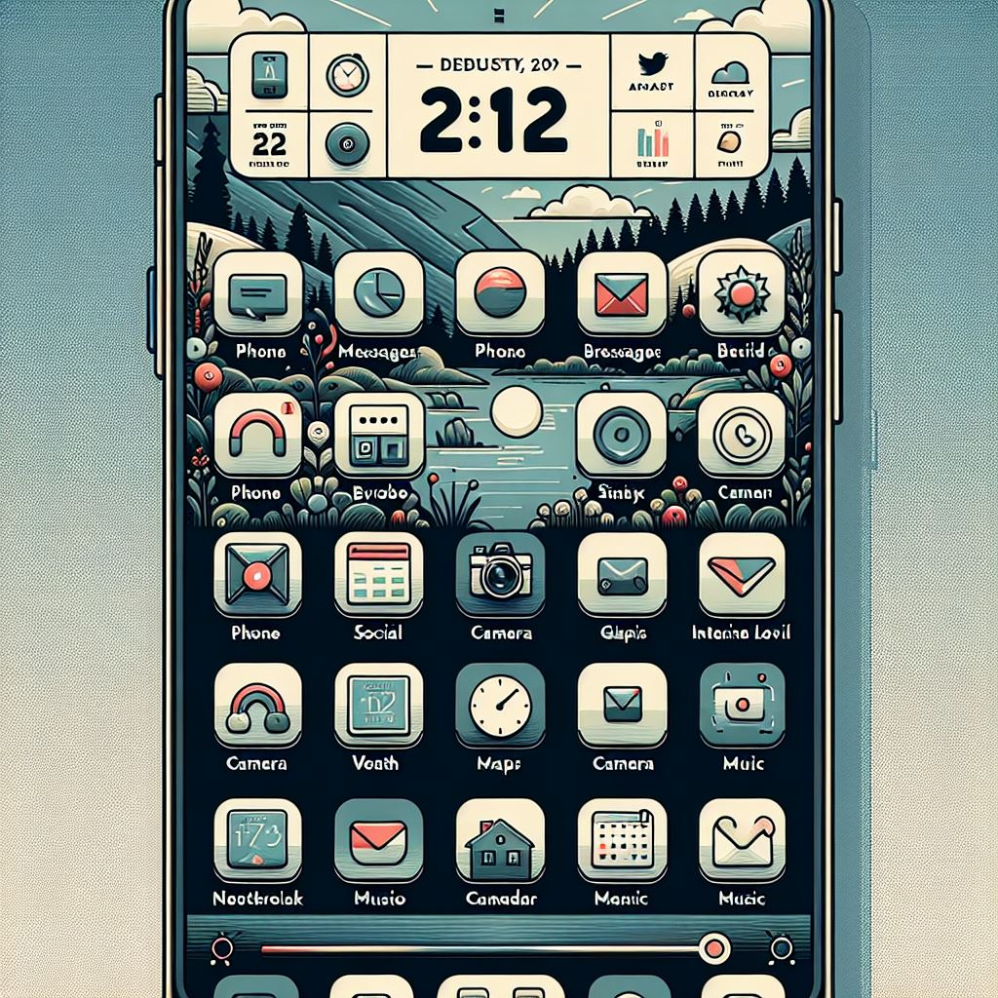
Navigating your phone
Home Screen
Apps
Texts and messaging
Making and receiving calls
Notes:
Home Screen and Apps.
Understanding the Home Screen Layout:
Let's start with the home screen. This is the main screen you see when you turn on your phone.
At the top, you might see the time, battery level, and signal strength.
In the middle, you'll see icons for different apps. These are shortcuts to open the apps.
At the bottom, you might see a row of icons that stay the same on every screen. These are usually for important apps like the phone, messages, and internet browser.
How to Open and Close Apps:
To open an app, just tap on its icon. For example, if you want to open the camera, tap on the camera icon.
To close an app, you can usually press the home button (if your phone has one) or swipe up from the bottom of the screen.
If you want to see all the apps you have open, you can:
swipe up from the bottom and hold, or
press the recent apps button (if your phone has one).
You can then swipe left, right or up to close apps.
Making Calls and Sending Messages
How to Make a Phone Call:
To make a phone call, tap on the phone icon. This will open the dialer.
You can either type in the phone number using the keypad or select a contact from your list.
Once you've entered the number or selected a contact:
tap the call button to start the call.
It usually looks like a green phone icon.
To end the call, tap the red phone icon.
Sending Text Messages:
To send a text message, tap on the messages icon. This will open your messaging app.
To start a new message, tap the new message icon (usually a pencil or plus sign).
Enter the phone number or select a contact from your list.
Type your message in the text box at the bottom of the screen.
When you're ready to send the message, tap the send button (usually a paper plane or arrow icon).

Slide 10

Be safe online
Notes:
Play this video.

Slide 11
Before I go
Check if you can do the following:
Power and charging
  Turn on a phone
  Charge it
Communication
  Make and answer calls
  Send and read text messages
Connect
  Turn on/off mobile data
  Connect to Wi-Fi
Apps
  Find apps
  Download apps (banking, maps)
Take a photo
Find the internet browser
Set an alarm or reminder
Notes:
Go through the list of things folks can do with their phones.
Ask people to show one another what they can do.

Slide 12
Let’s discuss
What is the first thing to do when setting up a new smartphone?
  a) Downloading apps
  b) Charging the phone
  c) Turning on the phone and following the setup instructions
  d) Making a call
Why is it important to use the correct charger for your smartphone?
  a) To avoid damaging the battery
  b) To charge the phone faster
  c) To make the phone look good
  d) To save money
3. What should you do if you receive a suspicious message or email?
  a) Ignore it
  b) Click on any links to see what it is
  c) Report it and delete it
  d) Forward it to friends
4. How can you keep your personal information safe on your smartphone?
  a) Share it with trusted friends
  b) Keep it private and use strong passwords
  c) Post it on social media
  d) Write it down and keep it in your wallet
Notes:
Ask the questions and ask people to share their answers.
The answers might be different for different people. You can ask people to justify why they chose one over the other.

Slide 13
Session overview recap
Understand the basic functions of a smartphone.
Learn what a smartphone is and its primary uses.
Get started with your smartphone.
Learn how to charge, turn on, and set up your device.
Navigate and use your smartphone safely.
Learn how to use basic features and stay safe online.
Want more information?
  Read the hand out, or
  go to: https://beconnected.esafety.gov.au/topic-library/computer-basics-for-beginners/what-is-a-smartphone, or
  Google “Be Connected get to know your smartphone”
Notes:
Review the session objectives.
Help people to find the Be Connected resource.

Slide 14
Thank you!

