Slide 1
Snackable Session #01
2024

Slide 2
Acknowledgement of Country
We acknowledge the Wadjuk people of the Noongar Nation as the original custodians of this land from which this session is being facilitated.
We also acknowledge the Traditional Owners of Country throughout Western Australia, and particularly those traditional owners from the lands on which you join us today.
We recognise their continuing connection to land, waters and contributions to community.
Together, we pay our respects their cultures, and to Elders both past and present.

Slide 3
Agenda
Purpose: To inform staff in Project Partner Organisations about the WA Digital Inclusion Project
Agenda:
Introduction to the WA Digital Inclusion Project
Digital Inclusion Website overview
eSafety and resources
Participant surveys, and tracking training

Slide 4
Learning Outcomes
By the end of this session you should be able to
facilitate a discussion or training session with colleagues and clients about the resources on the WA Digital Inclusion Project website and some eSafety principles
Participate in and share the relevant surveys for project monitoring and evaluation.

Slide 5
Project Overview
WA Digital Inclusion Project

Slide 6
WA Digital Inclusion Project: Initiatives
Strategy focus area | Supporting initiatives
Ability | Train ~1,500 front-line community service workers on the use of digital inclusion resources. Uplift the digital skills of at least 45,000 people in the community. Provide 100 scholarships to support people to obtain digital skills credentials.
Access | Establish a new digital inclusion website to support up to 50,000 WA community members to access digital inclusion resources and facilities. Provide 500 internet plan subsidies in a pilot with social housing residents.
Affordability | Provide 500 affordable devices in a pilot with social housing residents. Train 150 financial counsellors to support at least 1,000 people in selecting the best-fit affordable digital access option for them.

Slide 7
Partners and collaborators
Project Partners
More information about our project partners is available on our website
https://digitalinclusionwa.org.au/about-the-project/our-partners/

Slide 8
Project Monitoring and Evaluation
Monitoring and Evaluation Partner: UWA Centre for Social Impact
Train-the-trainer sessions
Sessions you run in your organisation
Initiative 1: 1,500 Front-line workers in Community Service Organisations – via train-the-trainer
Training your clients
Initiative 2: 45,000 Community members via Community Service Org’s
Community Champions

Slide 9
What is Digital Inclusion?
The Digital Inclusion Project is focused on supporting community members to
get affordable access to digital technology
develop skills to use digital technology
for work, learning and life.

Slide 10
Overview of the Digital Inclusion Project Website
digitalinclusionwa.org.au

Slide 11
Website content sources
WA Digital Inclusion Project | Train the Trainer Presentation | Snackable Session

Slide 12
eSafety - Introduction
WA Digital Inclusion Project

Slide 13
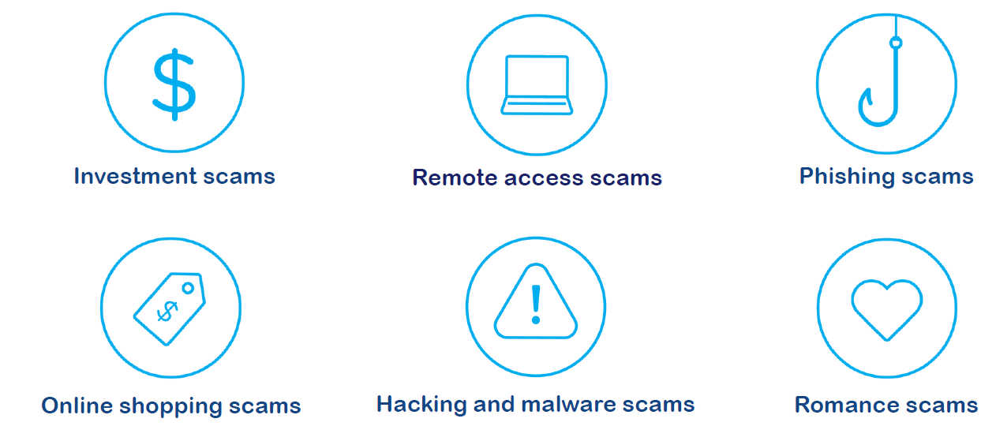
Types of Scams
From the NBN Scam Awareness Week resources

Slide 14
Tips to stay safe online
If someone is calling you and asking for personal information or access to your computer, take down their details, find their company’s number and call them back – or simply hang up!
If a text or email from a friend or family member seems strange or is asking for money, call them on the number you have for them and ask them to verify the information
Make passwords long and hard to guess
Be mindful of what you share on social media.
Trust your gut - don’t be fooled by people who are trying to scare you, charm you, or make you rush!

Slide 15
Scam Fitness
How to hang up on a scammer:
“I didn’t ask you to call me, so I am going to hang up the phone now”

Slide 16
Monitoring and Evaluation
WA Digital Inclusion Project

Slide 17
Project Monitoring and Evaluation
Train-the-trainer sessions
Sessions you run in your organisation
Initiative 1: 1,500 Front-line workers in Community Service Organisations – via train-the-trainer
Training clients
Initiative 2: 45,000 Community members via Community Service Org’s
Community Champions

Slide 18
Three layers of survey for 2 Initiatives
This training
Trainers in partner organisations
Training you deliver to colleagues
Following the train-the-trainer model
Surveys for clients
Initiative 1:
Train 1,500
frontline staff
Initiative 2: Uplift digital skills of 45,000 people

Slide 19
Delivering training to your colleagues and clients
Resources - available here DIGITALINCLUSIONWA.ORG.AU/TEACH
***Tracking participation is crucial to support the goals of the project***

Slide 20
Social Media
If you post on social media, please tag
@WACOSS and @Lotterywest,
and mention the WA Digital Inclusion Project in any posts.
Also – feel free to spread the word about the project website.
Here’s the link:
www.digitalinclusionwa.org.au
WA Digital Inclusion Project | Train the Trainer Presentation | Snackable Session

Slide 21
Contact Details
Project team: digitalinclusion@wacoss.org.au
Facilitator today: Elliot@wacoss.org.au
digitalinclusionwa.org.au
Telephone WACOSS: 08 6381 5300

Slide 22
Survey for completing this training
https://uwa.qualtrics.com/jfe/form/SV_6m85CaJI6rDj9lA?Q_CHL=qr

Slide 23
Survey for when you deliver training to colleagues
https://uwa.qualtrics.com/jfe/form/SV_1UgaYamlw8MkO2O?Q_CHL=qr

Slide 24
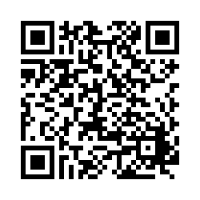
Survey for your clients
There is also a PDF version of this survey if you wanted to print and give a copy to people in your organisation. This will be available at digitalinclusionwa.org.au/teach
https://uwa.qualtrics.com/jfe/form/SV_2gzi9qHPtqv67Fc?Q_CHL=qr

